Slide 1
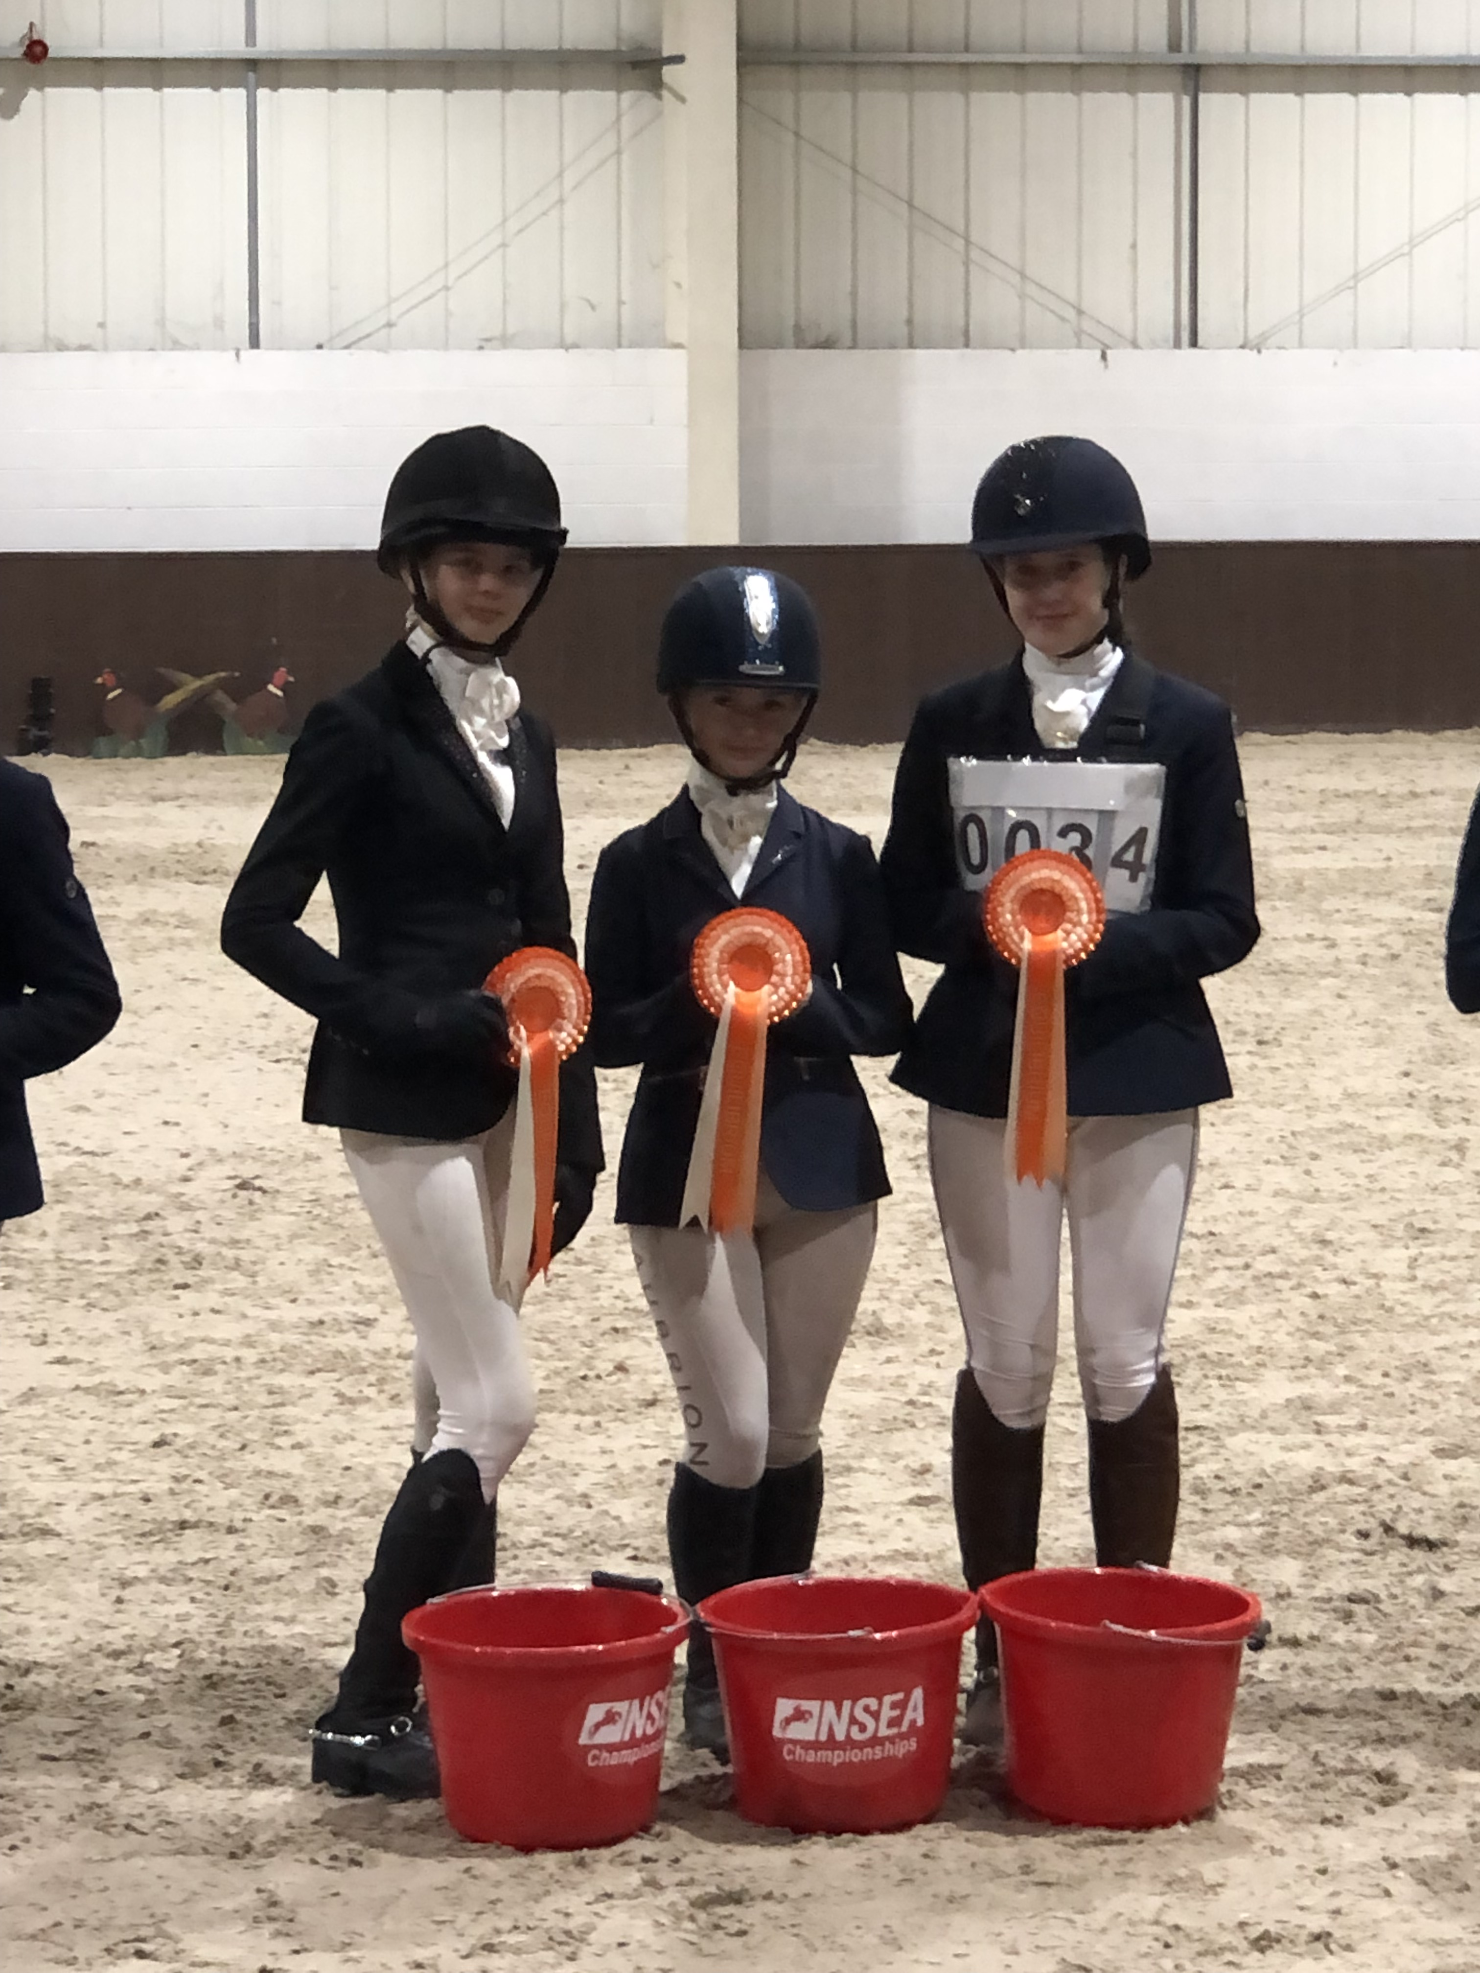
Including
Cherry Trees Chatter

Slide 2
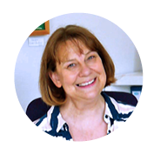
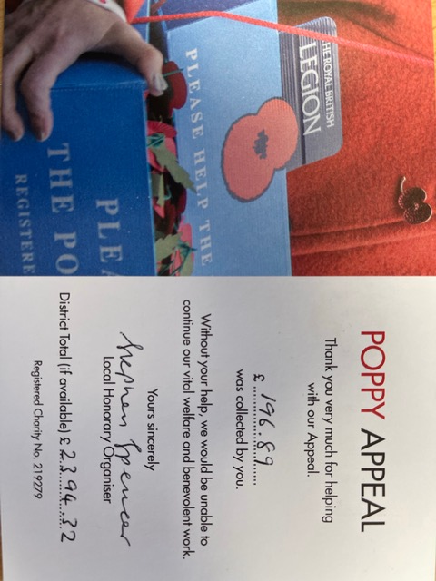
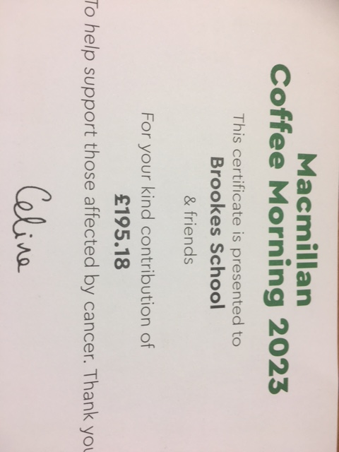
Dear Parents,
Autumn term is such a busy with our families joining our school and more recently with all Christmas events.
It was so good to see so many parents joining us to celebrate their child's learning at Book Looks and Assemblies. I am very pleased with our new initiatives and enhanced curriculum such as the Design & Technology for Lower School and Key Stage 3 which is showcased in this edition. A big thank you for the PTA for helping these initiatives too by funding sewing machines.
I was overwhelmed with all your generosity both with our Harvest collections and the ‘Christmas Shoebox Appeal’, thinking and caring for others is so important as well as celebrating our own success.
Our Parent Portal is now up and running, I hope you have all managed to download the app, which will keep you updated on Diary events and also your child’s achievements.

Slide 3
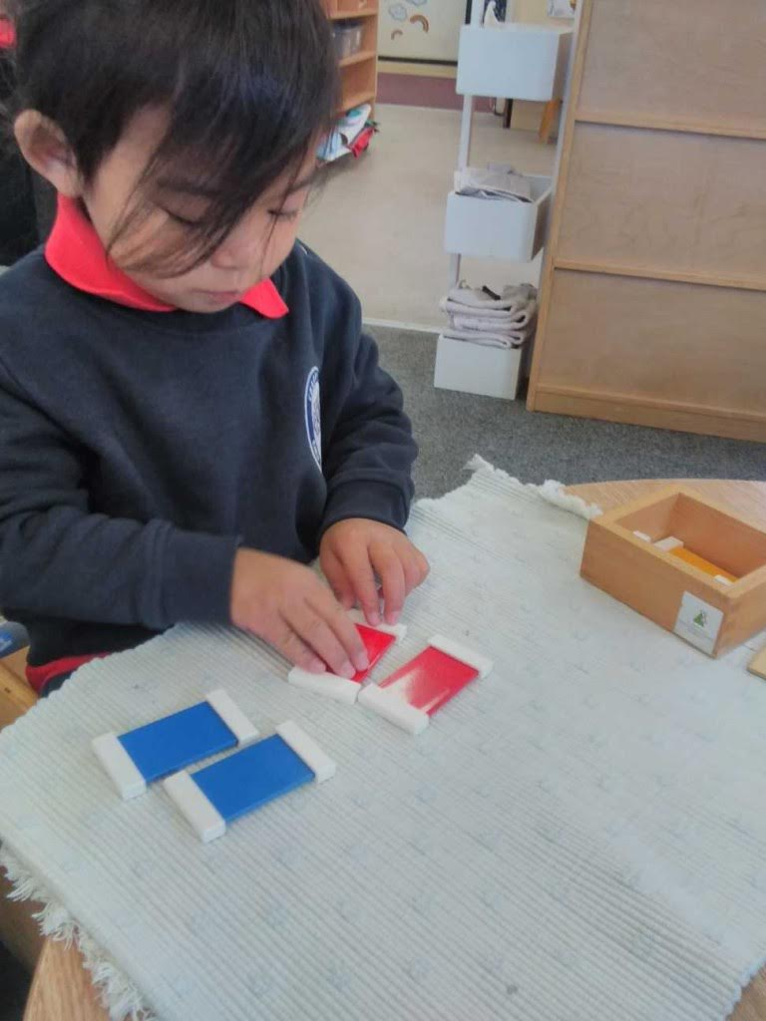
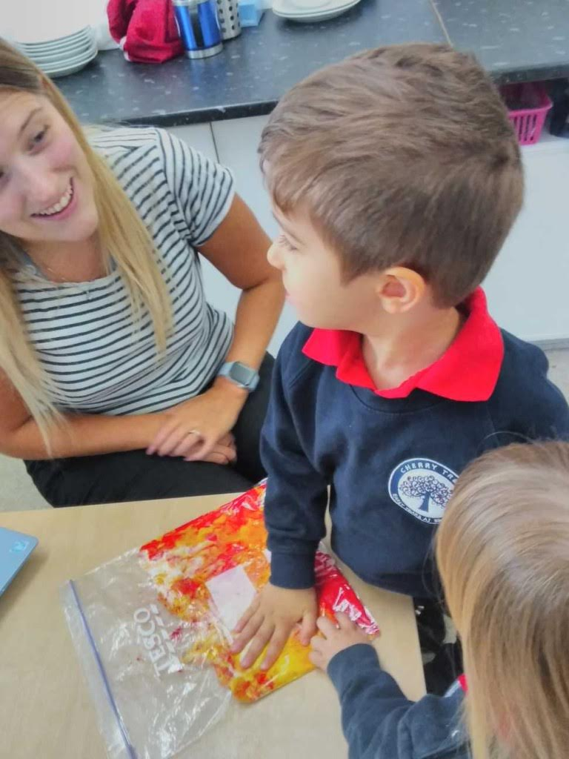
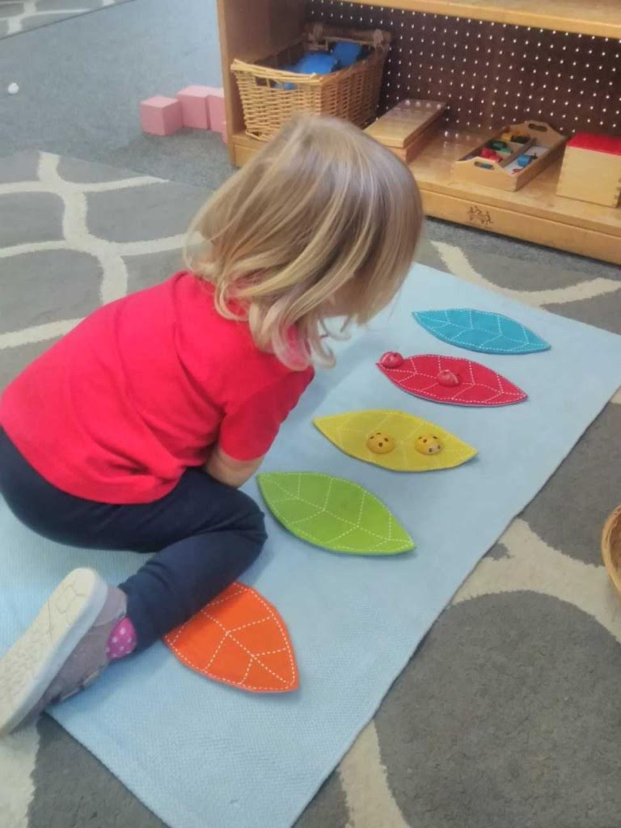
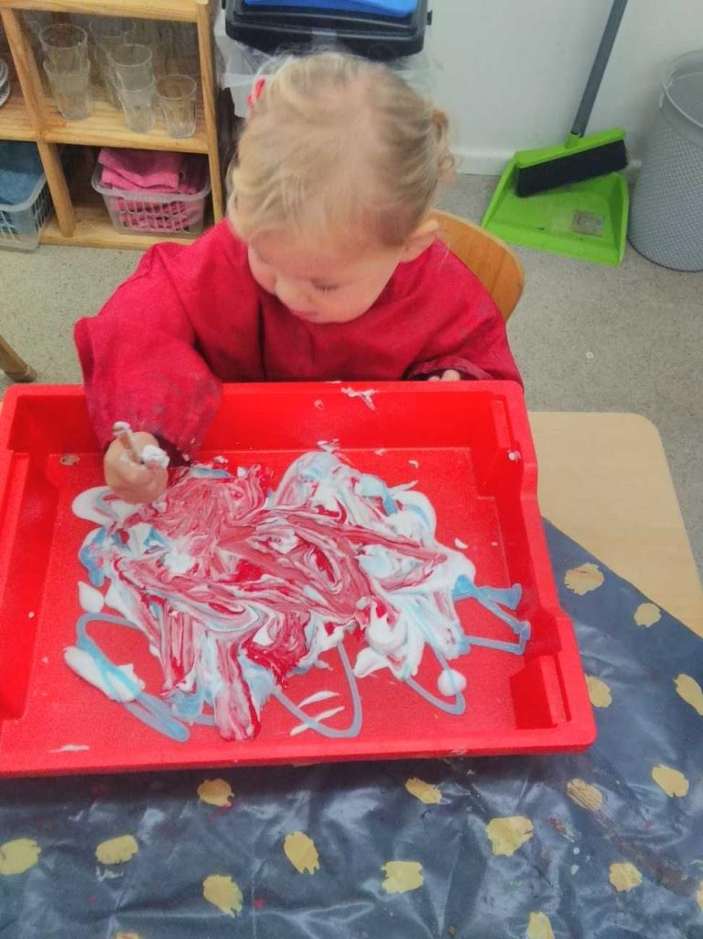
In the Caterpillar Room we have been focusing on colours and shapes whilst continuing to explore the Montessori equipment. We have also been looking at the three primary colours, matching colours together and exploring what happens when we mix them together.
.

Slide 4
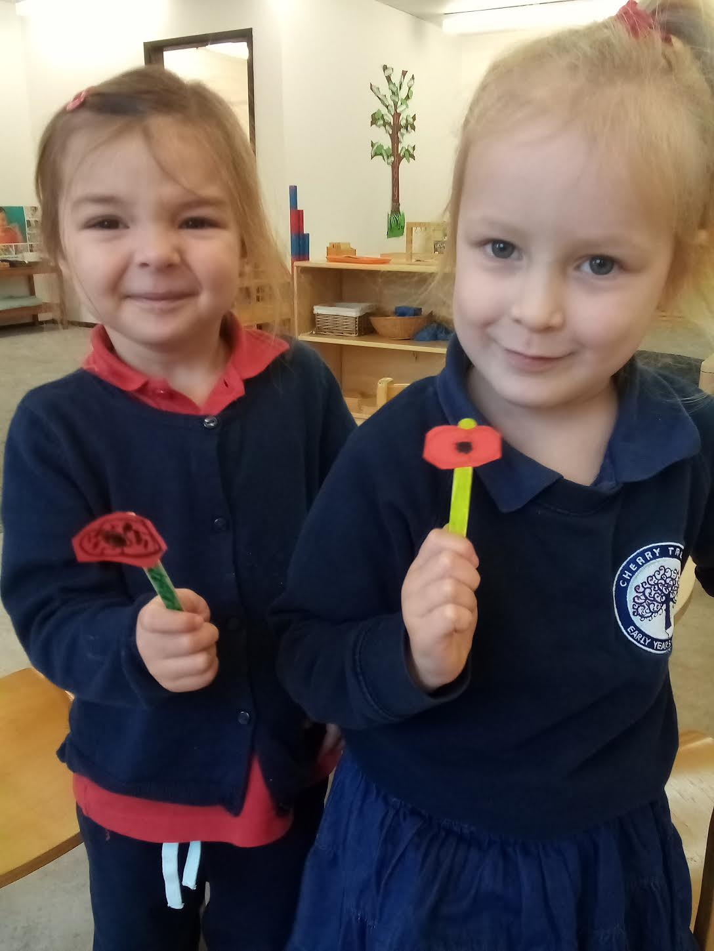
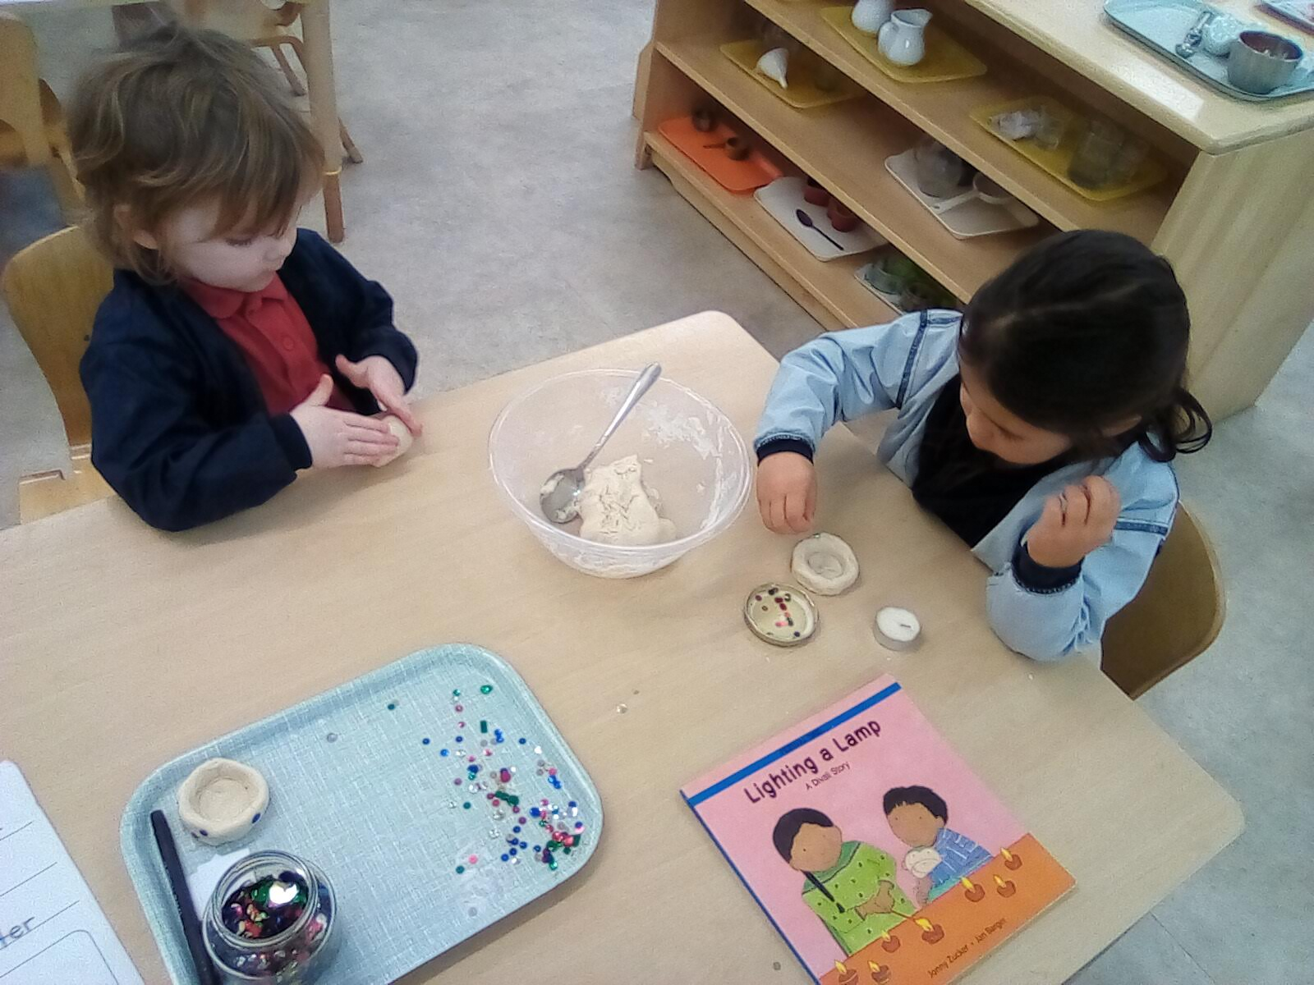
The children all enjoyed creating their own poppies whilst we talked about
what Remembrance Day is all about in a gentle way.
The children were very proud of their poppies, and we were very proud of
their concentration and lovely questions about Remembrance Day.
The children in the Butterflies Room have had a wonderful time learning
about the Hindu celebration of Diwali. They spent time discussing cultural
differences and celebrations around the world.
Here they are making their own Diya Lamps.

Slide 5
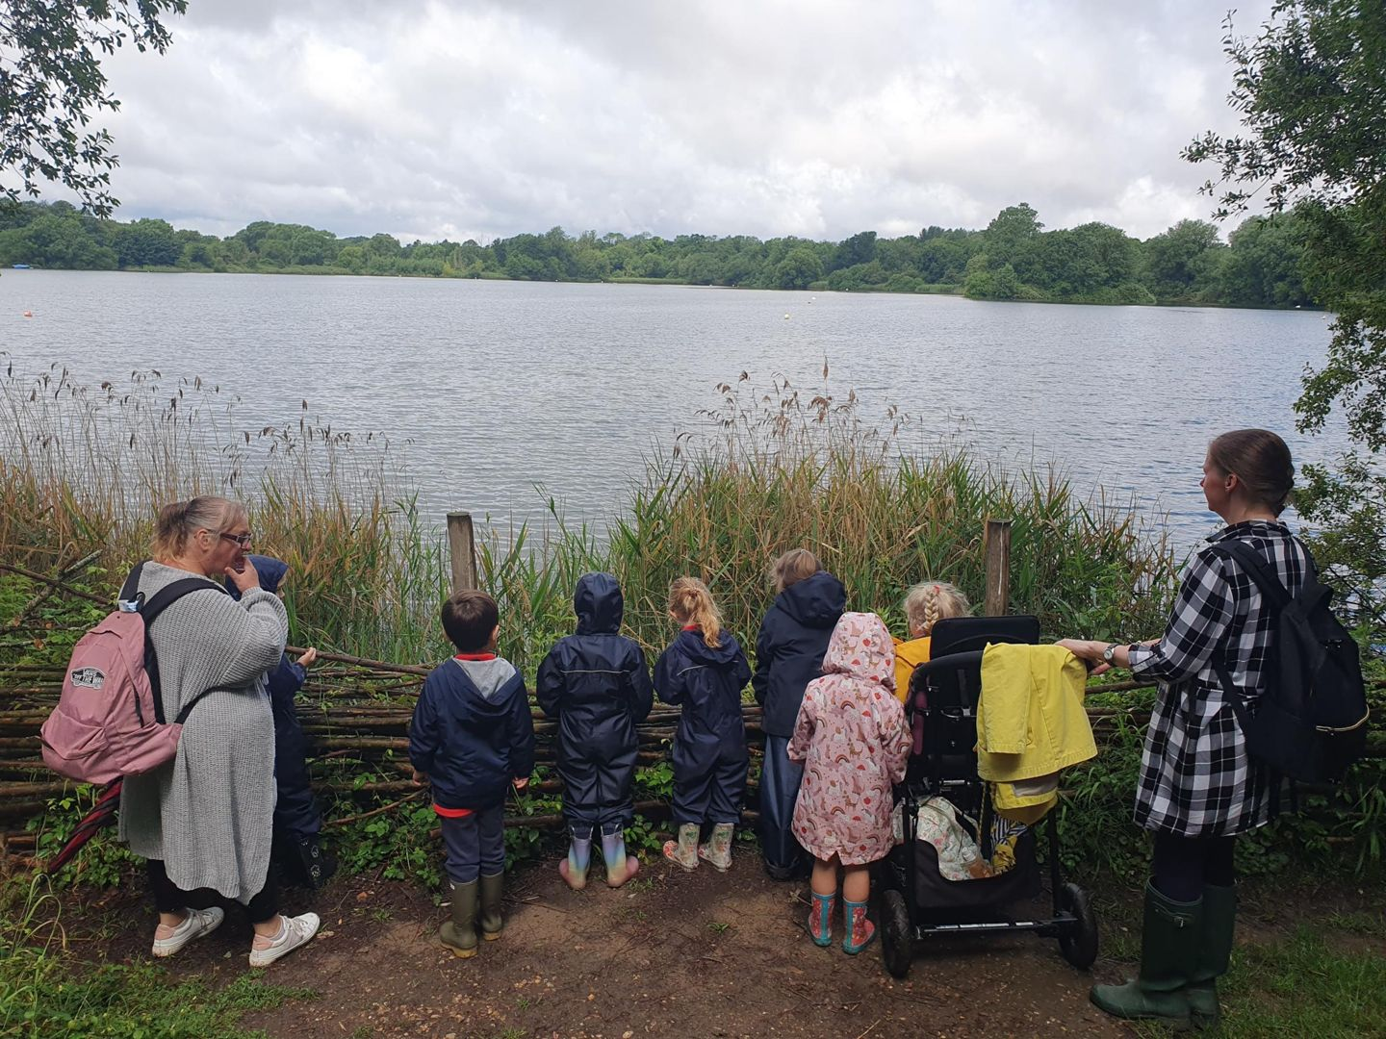
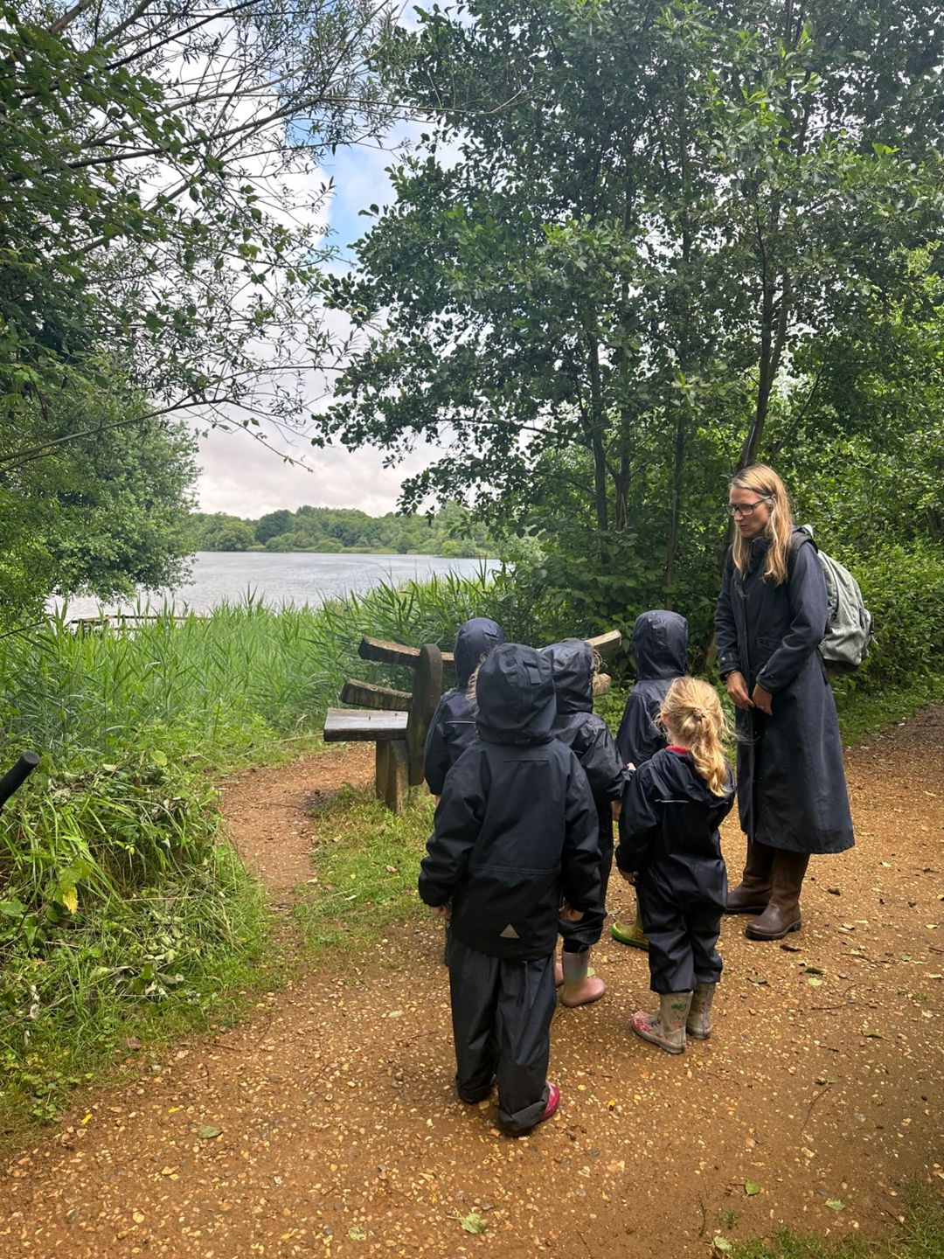
Reception Class thoroughly enjoyed a trip to Lackford Lakes. The weather didn’t dampen their spirits, they used it to their advantage and had a great time bug hunting. Before long the sun was shining and the children were able to spot dragonflies, damselflies, herons and many swans.
We are so fortunate to have such peaceful surroundings on our doorstep.
.

Slide 6
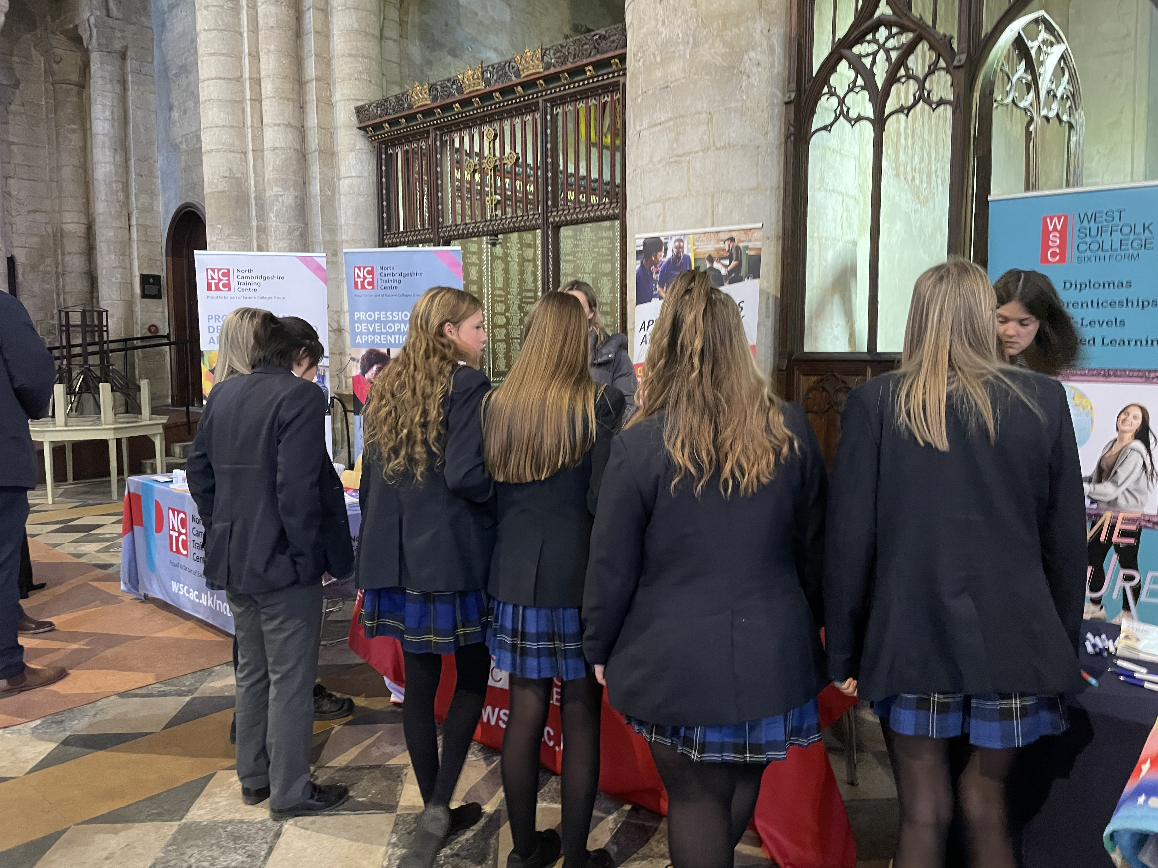
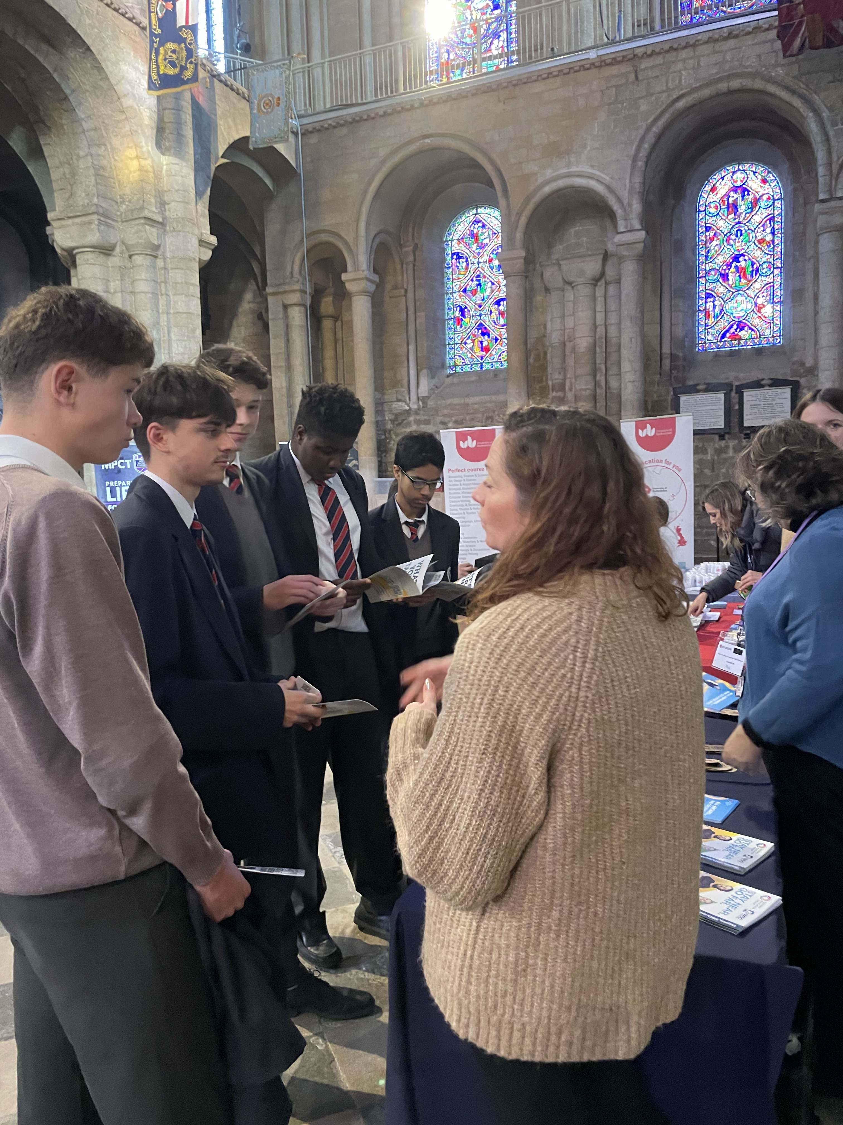
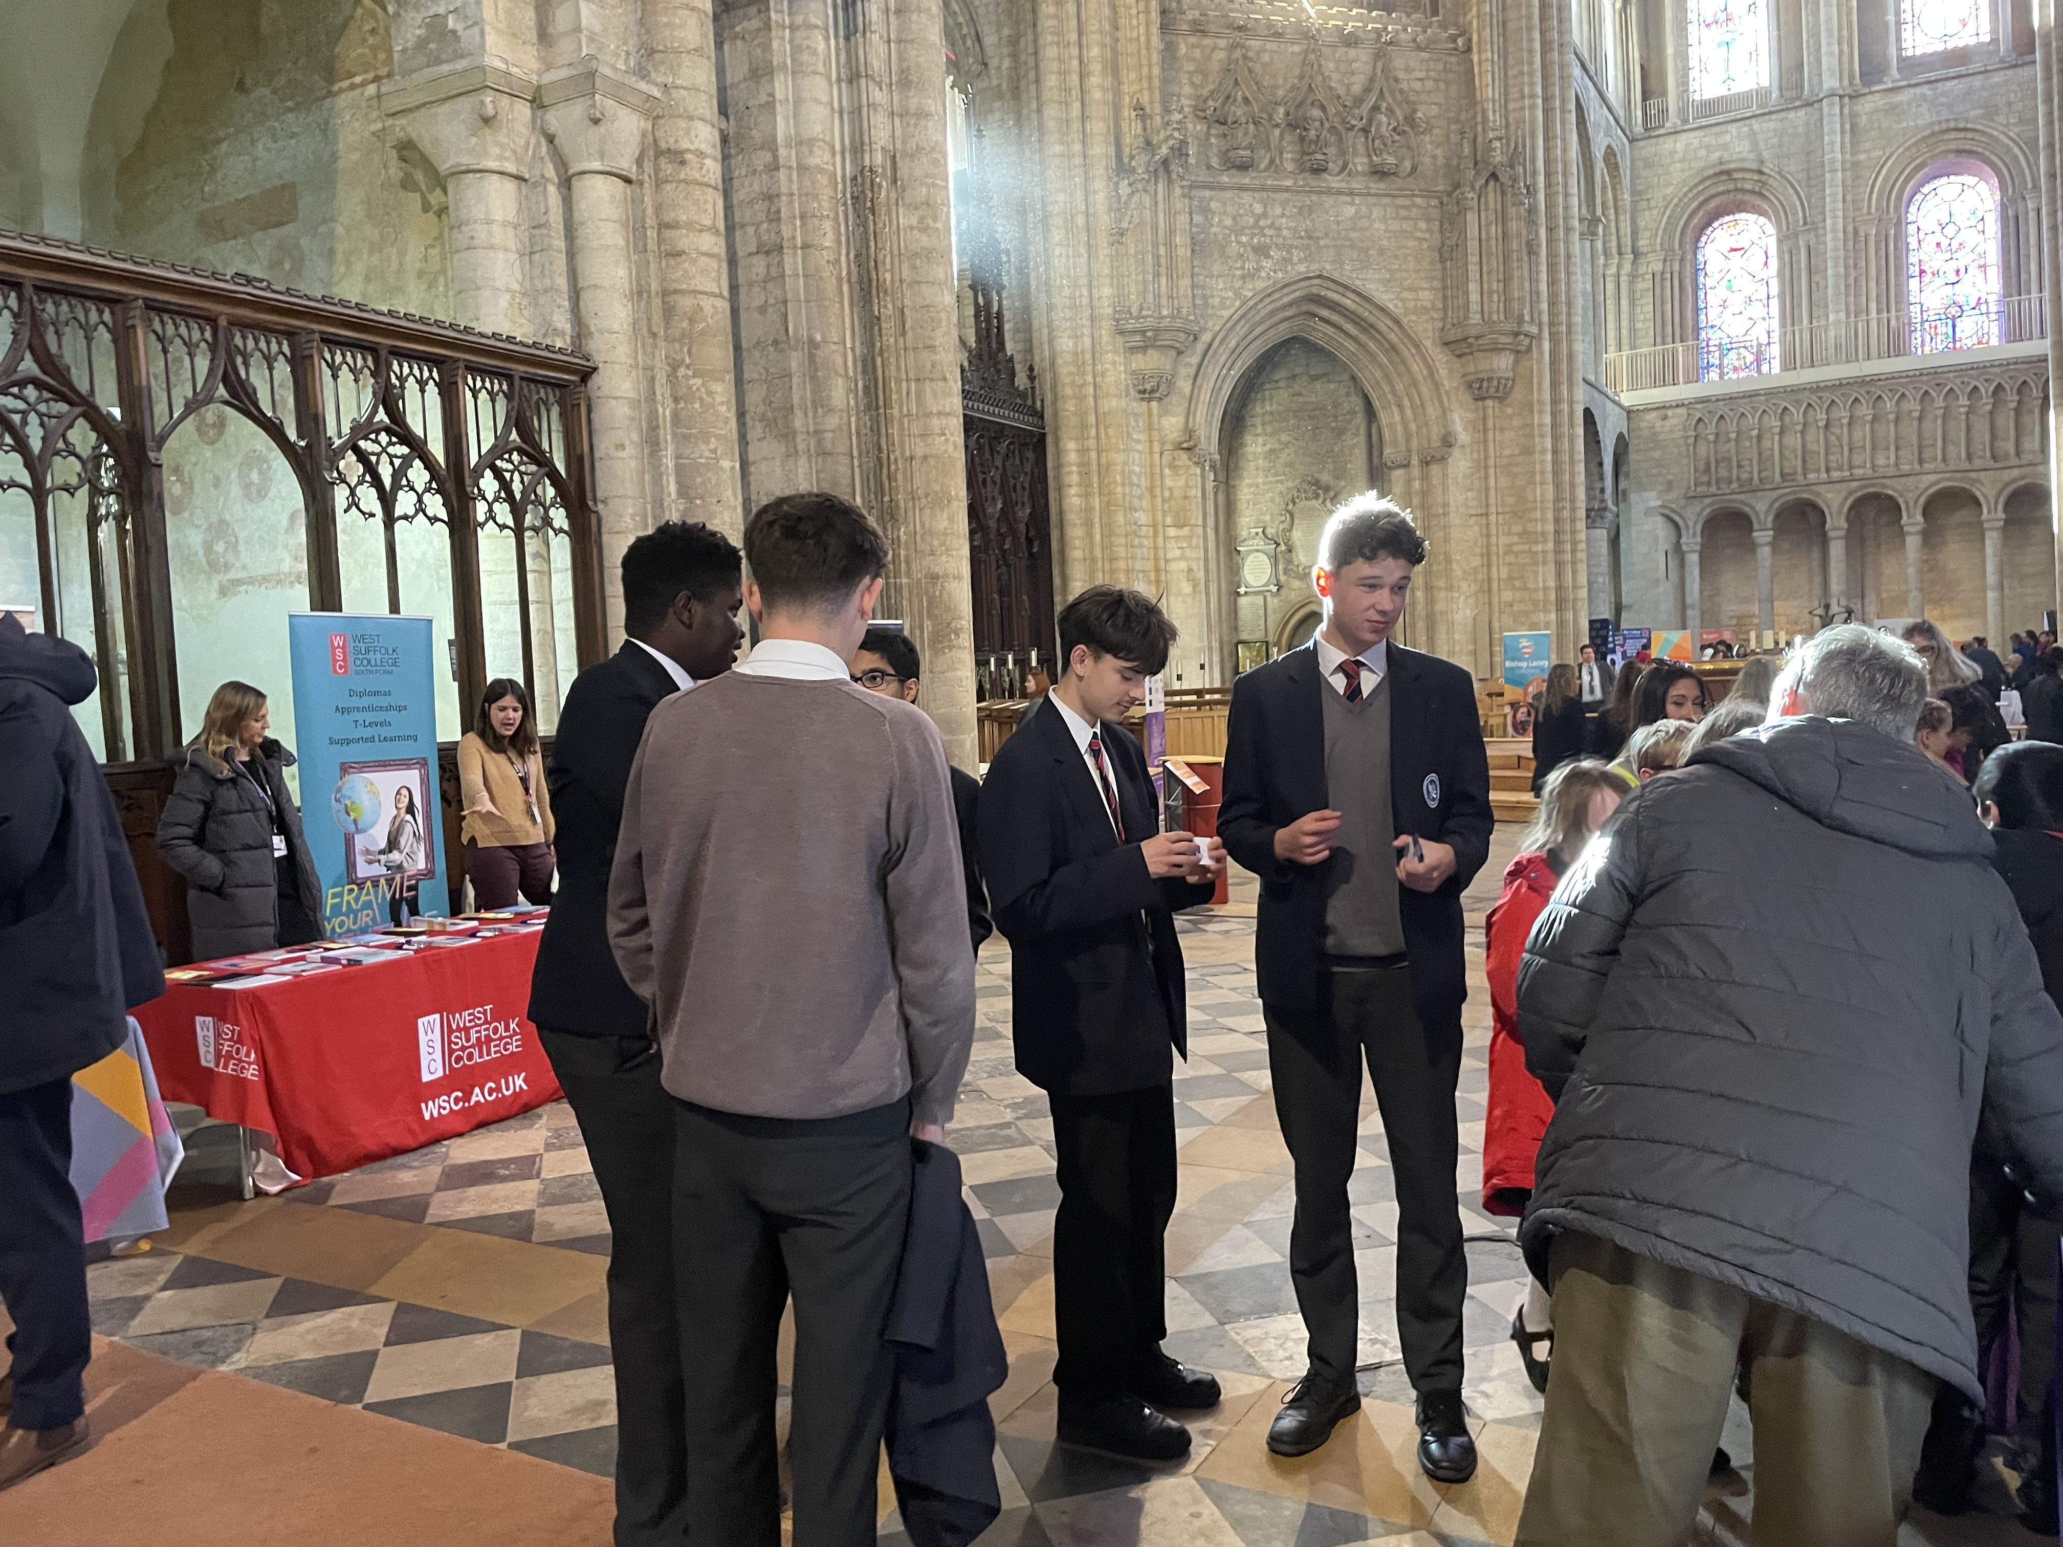
Careers Fair
To help our Y11 students with deciding their next steps. Brookes UK students visited the careers fair held in Ely Cathedral. This was a brilliant opportunity for the students to look at a variety of different options for next year, including A-levels and apprenticeships An informative and thought provoking experience.

Slide 7
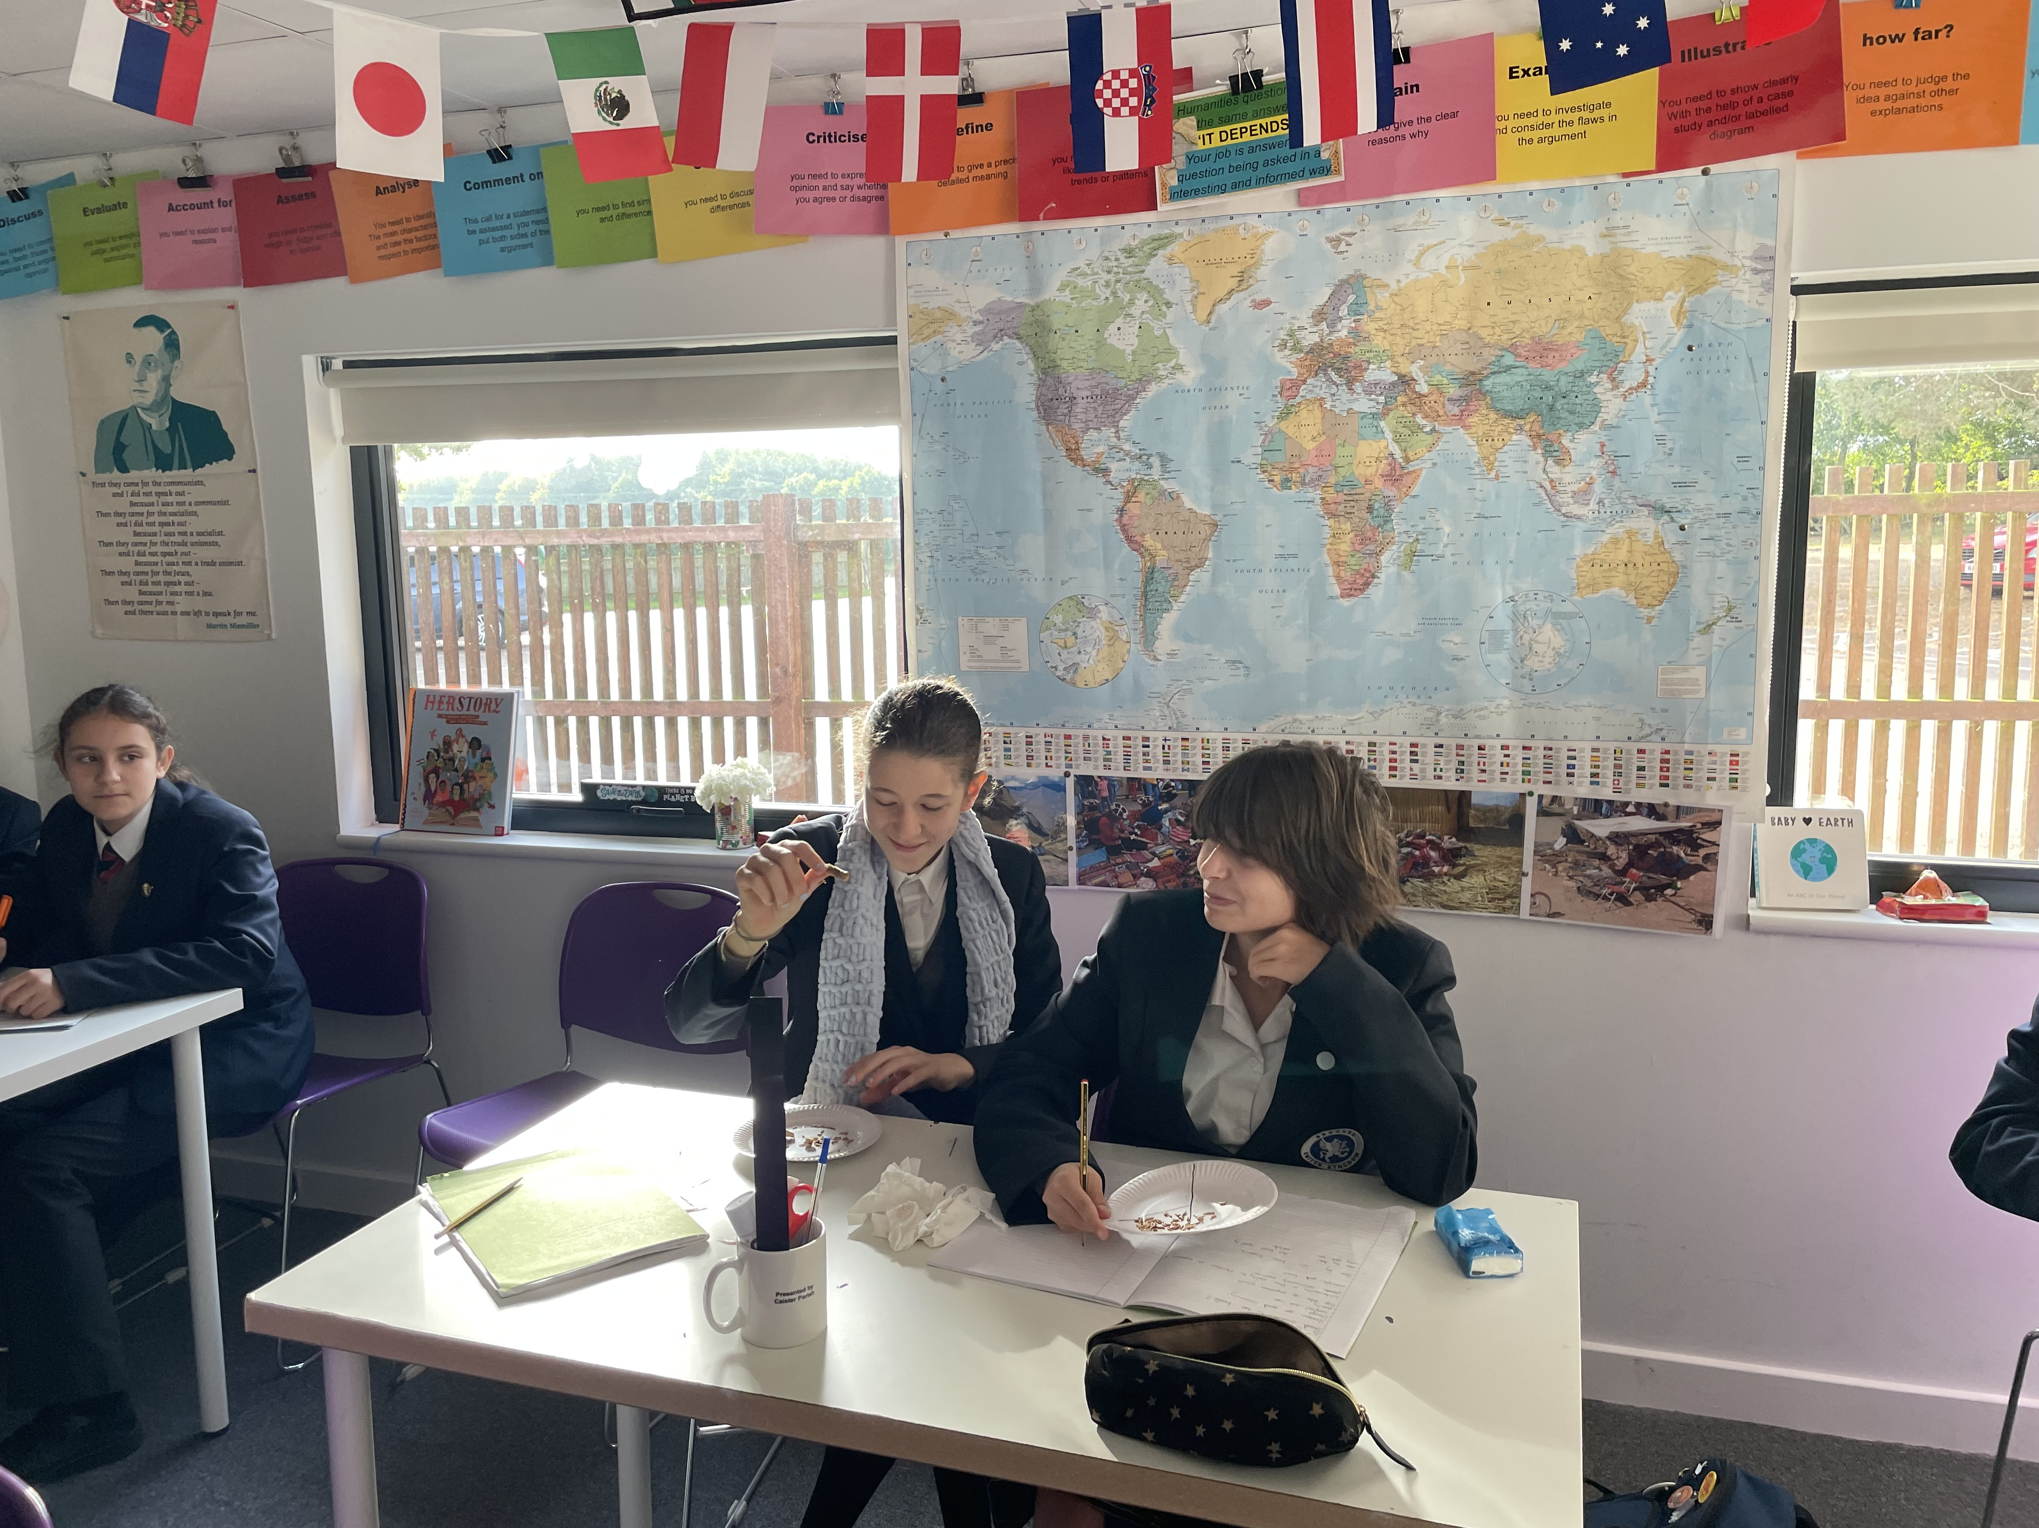
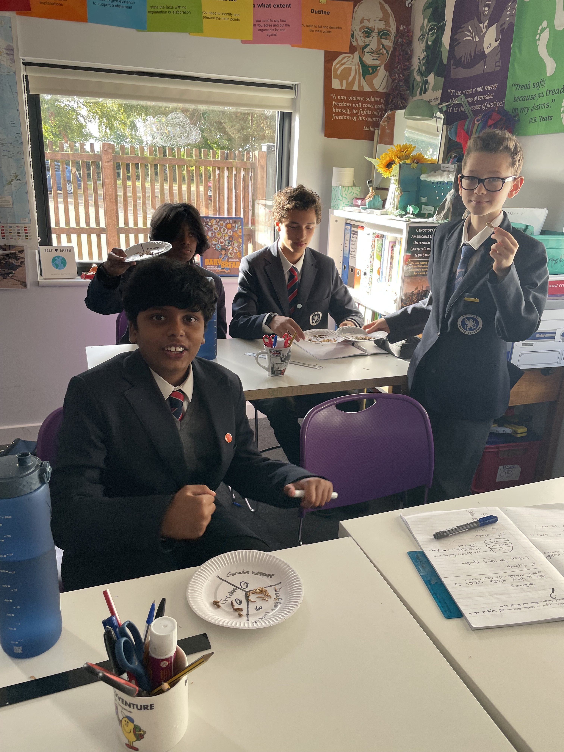
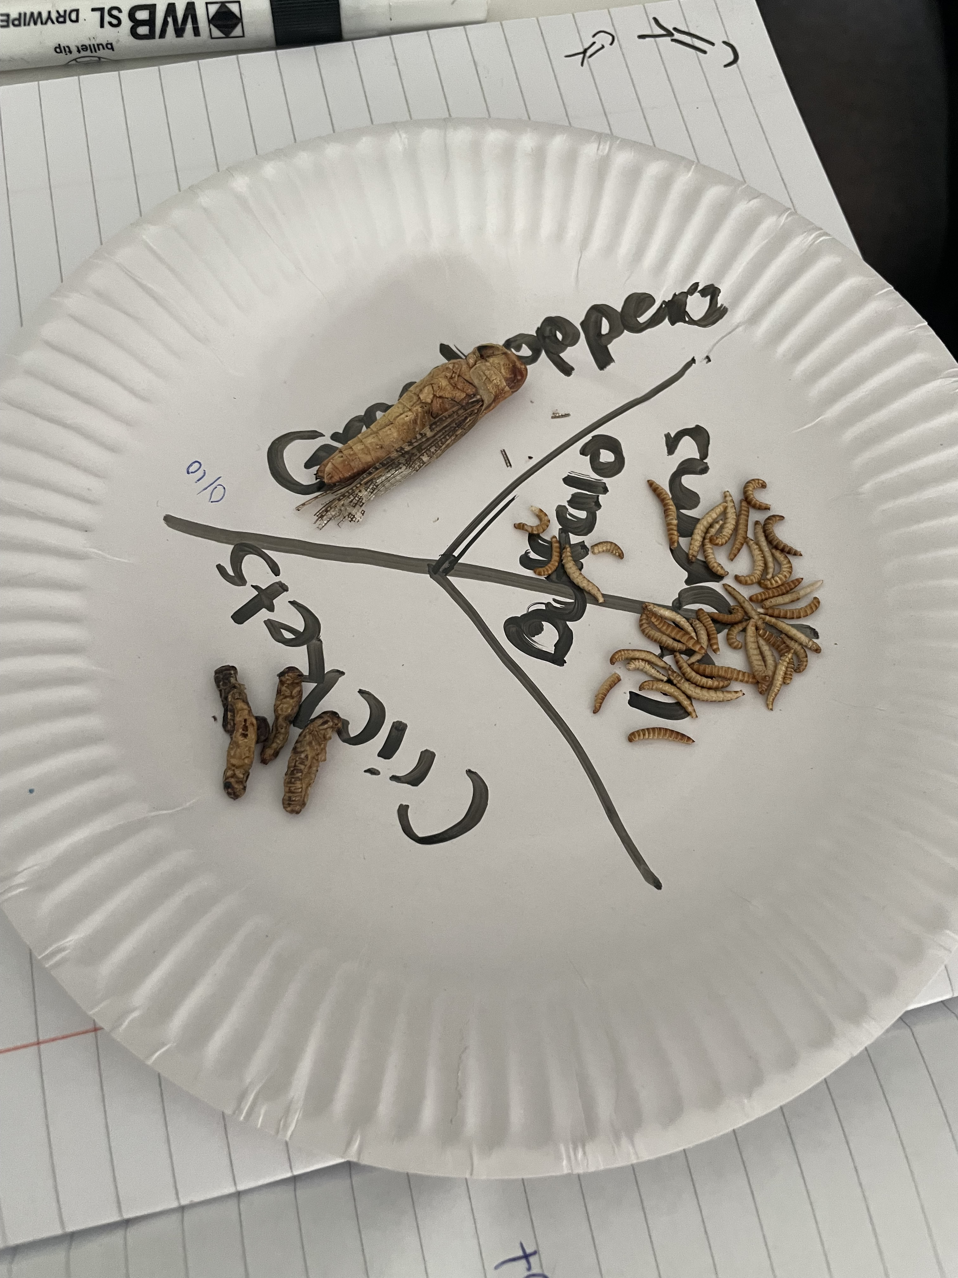
Humanities
As part of year nines investigation into global food security, we have been looking at different sustainable options for food supply. One of these could be the use of insect protein. In today’s lesson the students got the opportunity to try a selection of insects. Would you be brave enough to eat a cricket?

Slide 8
Your Childs Networking Safety
I have started a once a term Internet safety week where all the students from year 3 upwards have at least one lesson on staying safe, happy and healthy while using the web, this includes
social networking safety. This can only be fully effective with your support. Social networking apps do have an age rating, this is usually 13 but some, such as whatsapp have a 16 rating. As
parents we all need to do our best to protect and support our children so I will be posting in every newsletter any issues that we need to be aware of. Please be aware that we can use
parental settings on most home routers to control your child’s access to the web and to restrict the time they spend online. I include two links to the NSPCC web site with information
about Whatsapp and snapchat. If required I will be happy to talk to any parent who needs advice.
https://www.nspcc.org.uk/keeping-children-safe/online-safety/online-safety-blog/2023-01-12-is-whatsapp-safe-for-my-child/
https://www.nspcc.org.uk/keeping-children-safe/online-safety/online-safety-blog/is-snapchat-safe-for-my-child/
This term years 7, 8 and 9 have been getting to grips with computer coding, creating
algorithms and pseudo code. Years 10 and 11 have been working towards their GCSE. The
younger end of the school has been developing their general computing skills using word
processing applications to create documents
Bill Pipe, IT teacher

Slide 9
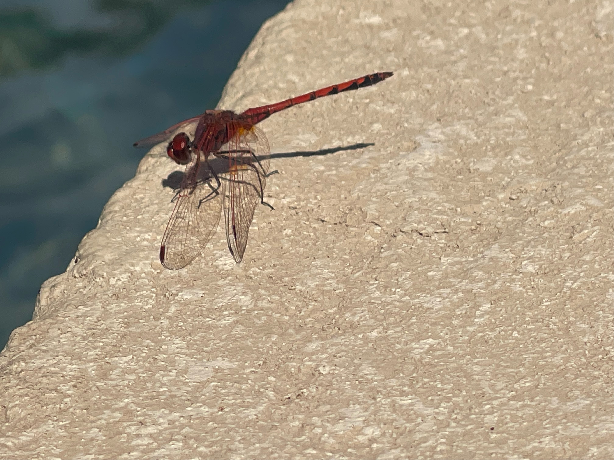
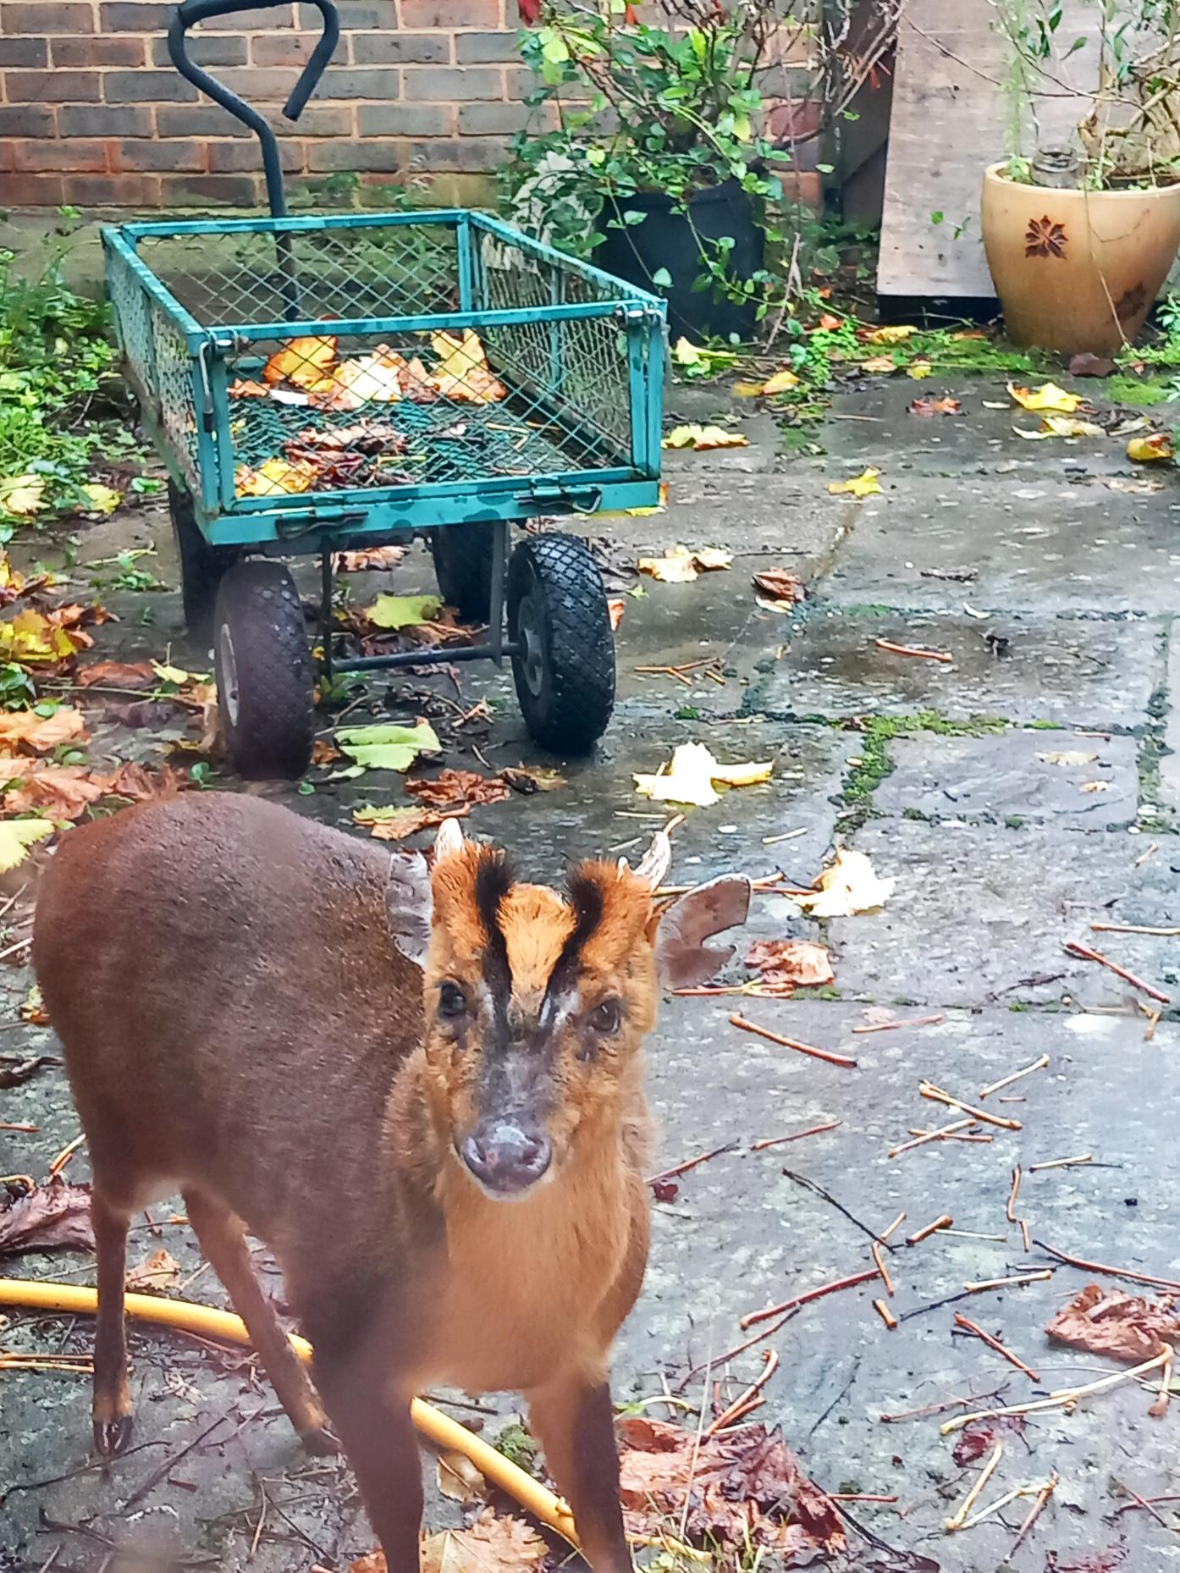
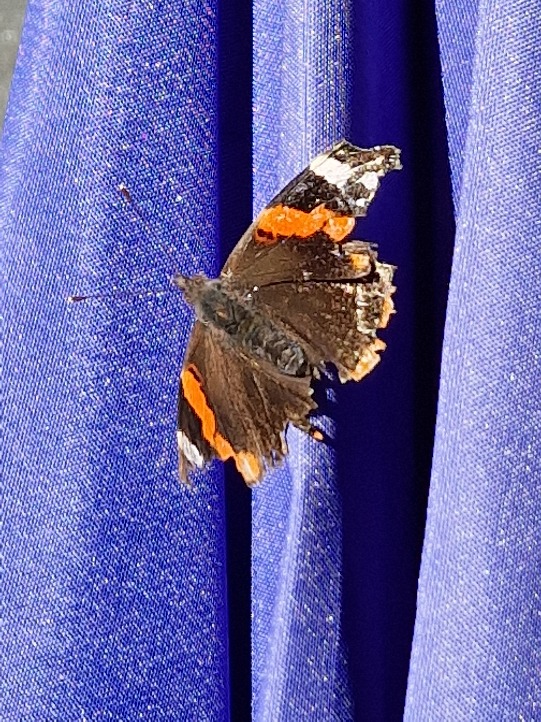
PHOTO COMPETITION
TOPIC WILDLIFE
We ran a Photography competition over half term and. The standard of entries was very high but after a very difficult task we chose;
1st Place Callum Keane
2nd Place Ryker Jackson
3rd Place Beatrice Hart

Slide 10
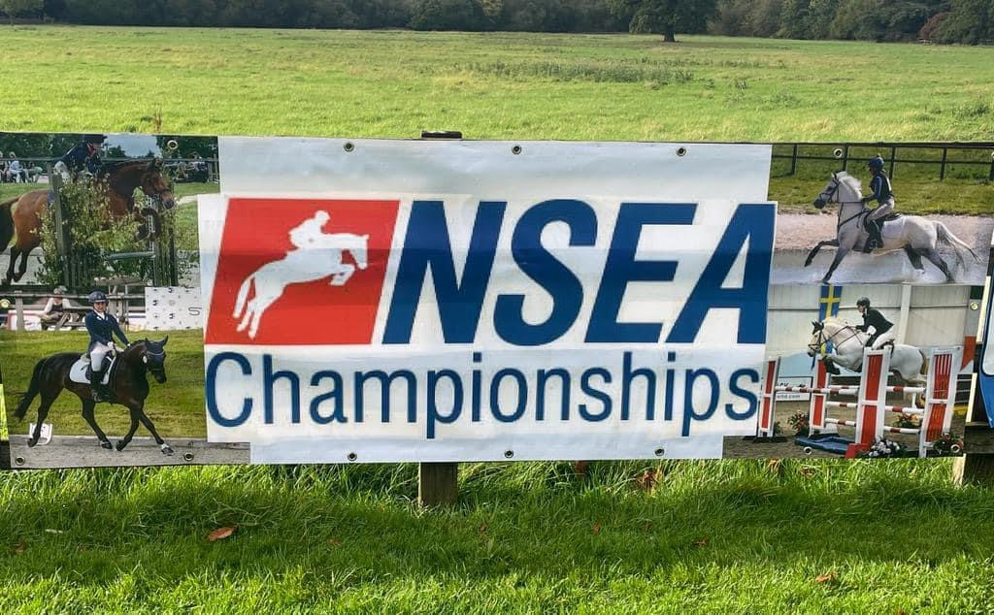
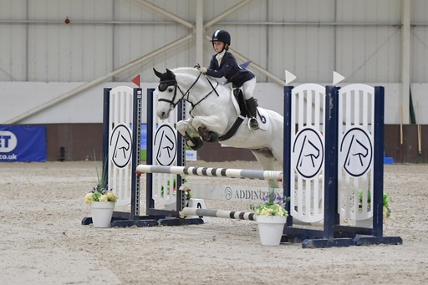
The Championship final was held at Addigton Equestrian indoor International Arena and the atmosphere was electric! Two large grandstand seating areas - filled with spectators, a restaurant with viewing area, TV cameras, a large commentary box and music playing meant there was a lot for the girls and ponies to cope with. A quick course walk, warm up and final team talk meant they were ready to go into the very busy collecting ring, before being called in to jump. Emily was first to go and flew round, making good time with just an unfortunate glance off the second to last. Quickly corrected and represented, she jumped the last fence clear. Harriet was quick off the mark and made some tight turns to produce a clear round in very good time. Last to go was Olivia and she jumped a sensible steady clear for the team, leaving us with a good overall finishing score. We were delighted to be called into 7th place at prize giving. With so many teams and schools from all around the country coming to compete here, to finish in the top 10 nationally at these Championships is a huge achievement. Especially when our team has only 3 riders and many others had 4 riders per team to count their top 3 scores.

Slide 11
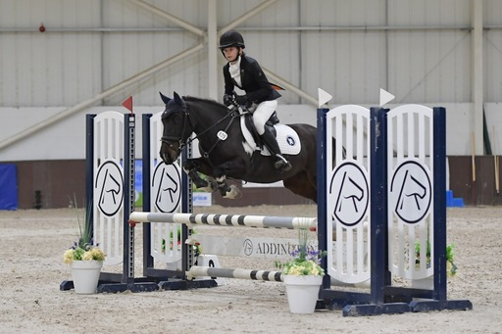
I am so very proud of the girls and their ponies. They all showed true team spirit and it was lovely to see them encouraging and supporting one another. The ponies were all amazing; jumping beautifully and coping with a stay away and a big atmosphere incredibly well. All three girls were wonderful ambassadors for our school and it was a pleasure to be there working with them.
I have to also say a massive thank you to the parents and support teams at home that help to make these opportunities possible for the riders. It's quite a challenge to get organised for a stay away competition, making sure horse and rider fitness is correct and that they feel prepared for the competition. Thank you also to Brookes UK for the unwavering support to our equestrian team. The girls were all proud to wear their new logo embroidered saddle cloths and ride for their school.
As always, I am looking for new members to join our team. NSEA offers opportunities to compete at dressage, show jumping and arena eventing. You can even ride your dressage tests at home and upload them for scoring. Jumping starts at 30cm and runs through to 1.10m. Lead rein assistance at the lower heights is also allowed.
Please contact me to find out more as we would love to welcome new members! Please contact office@uk.brookes.org.
Leanne Livall, Equestrian Team Manager

Slide 12
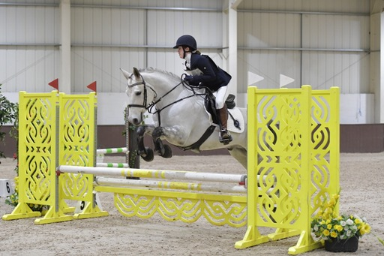
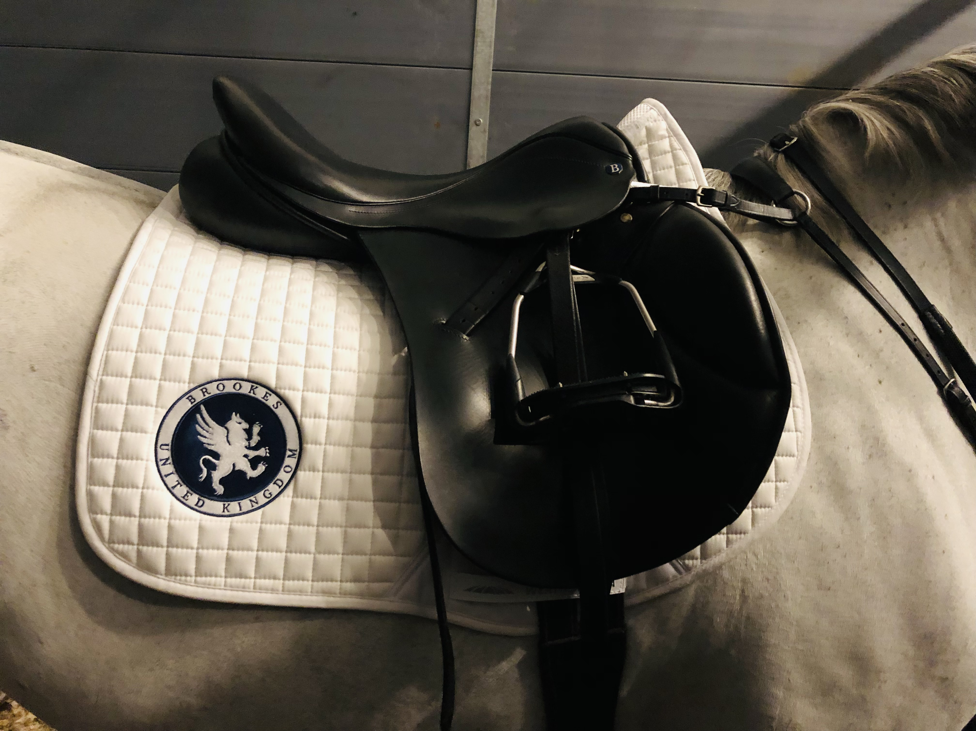
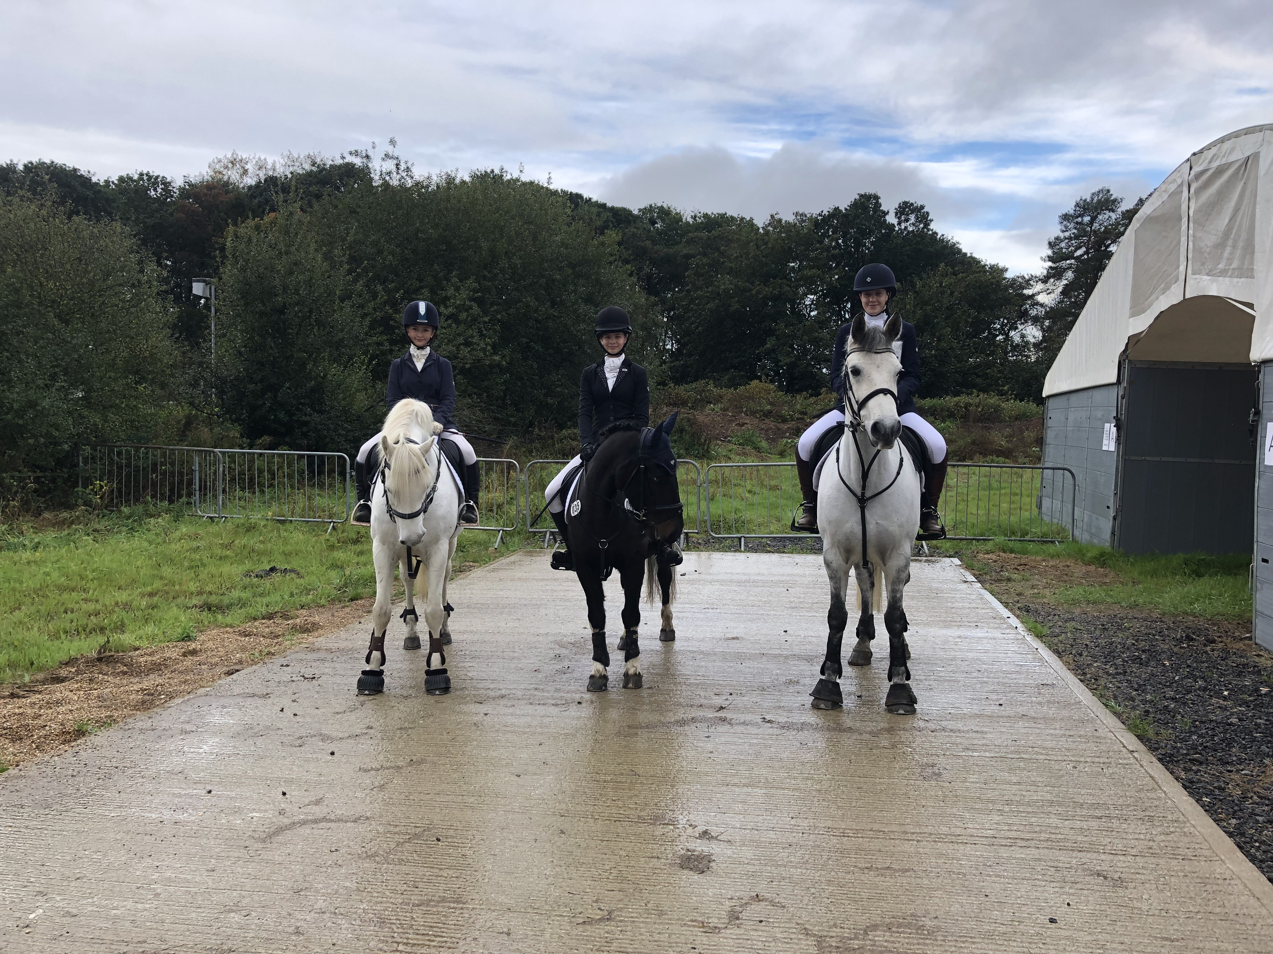

Slide 13
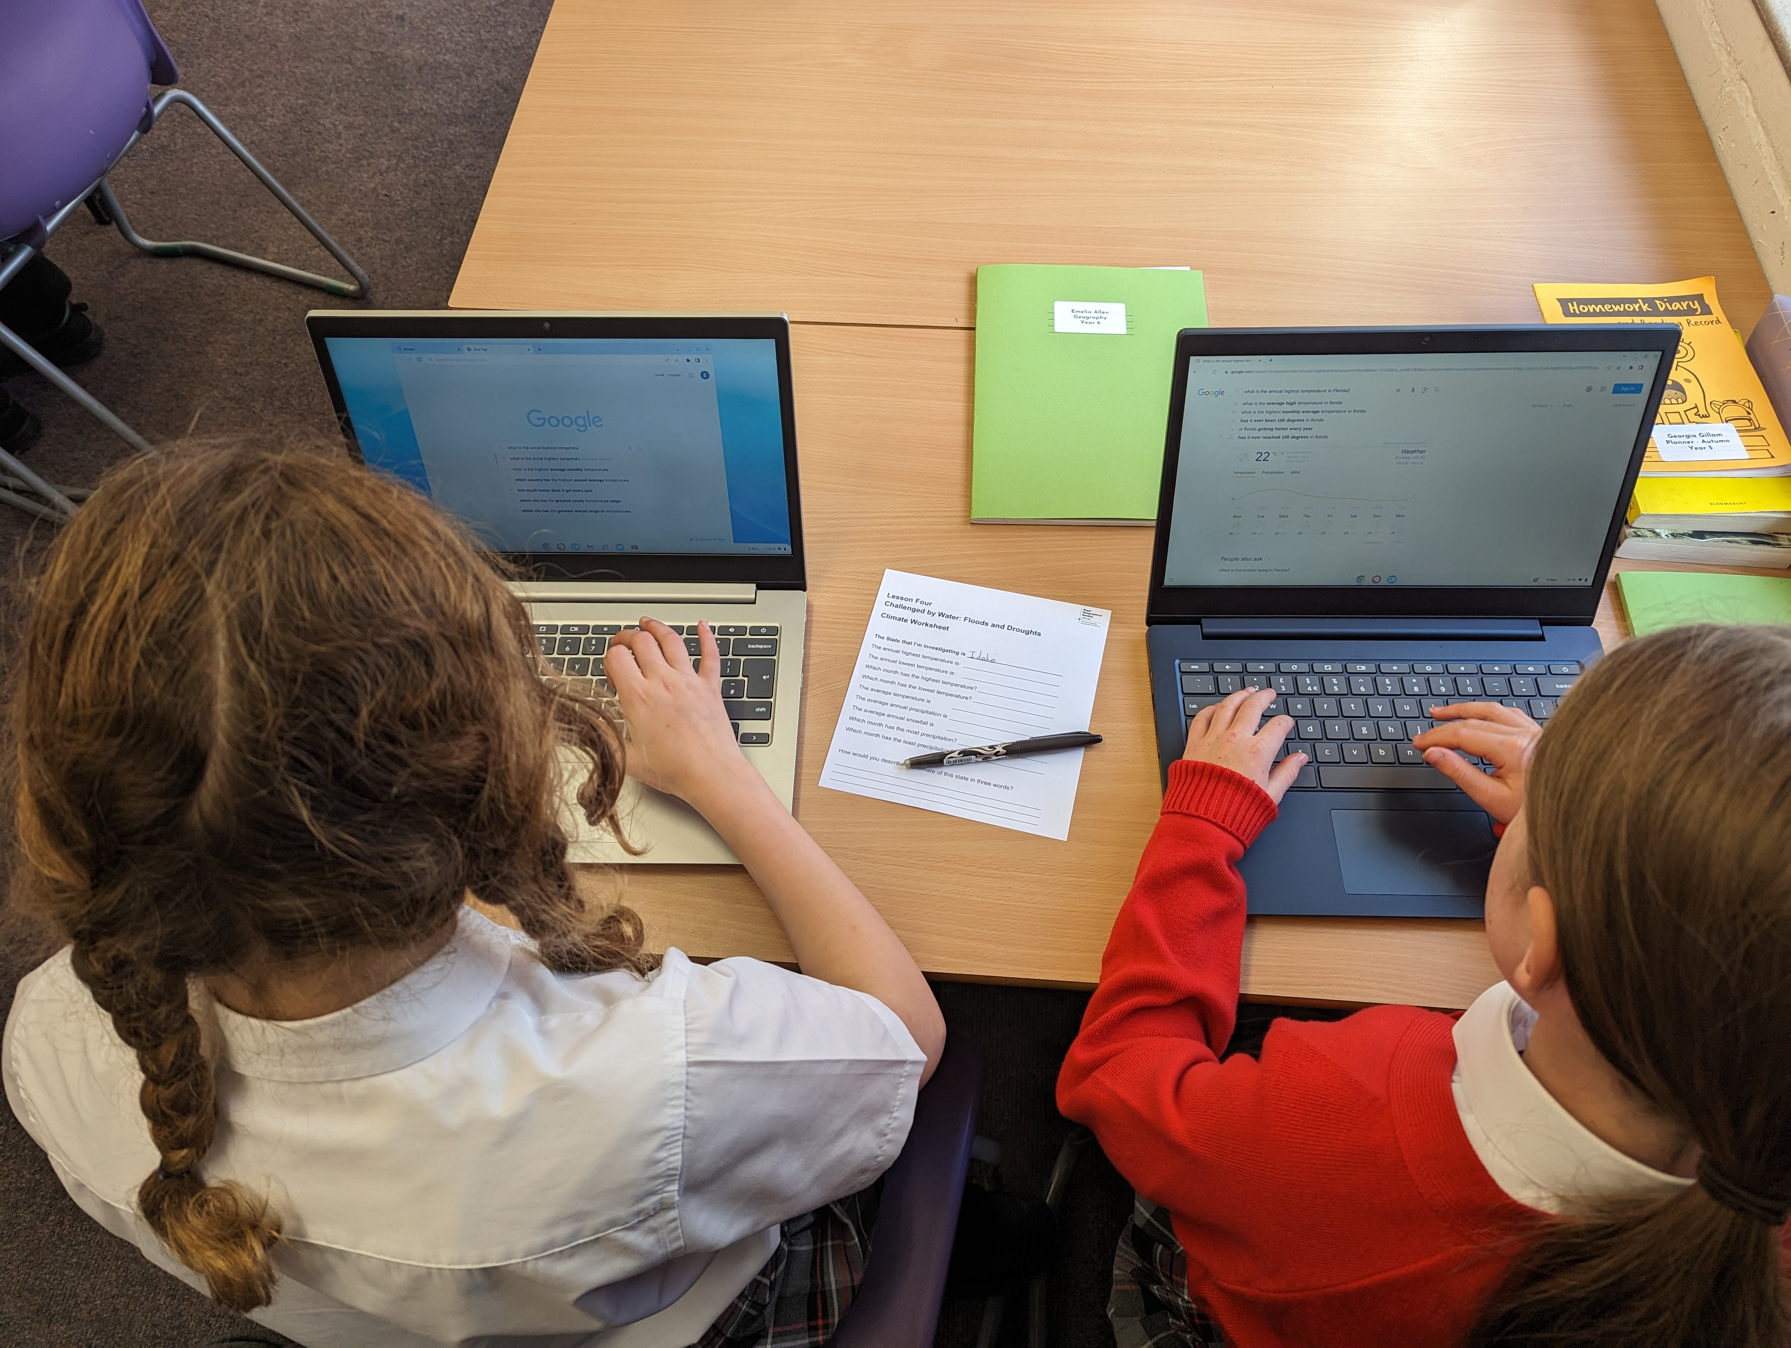
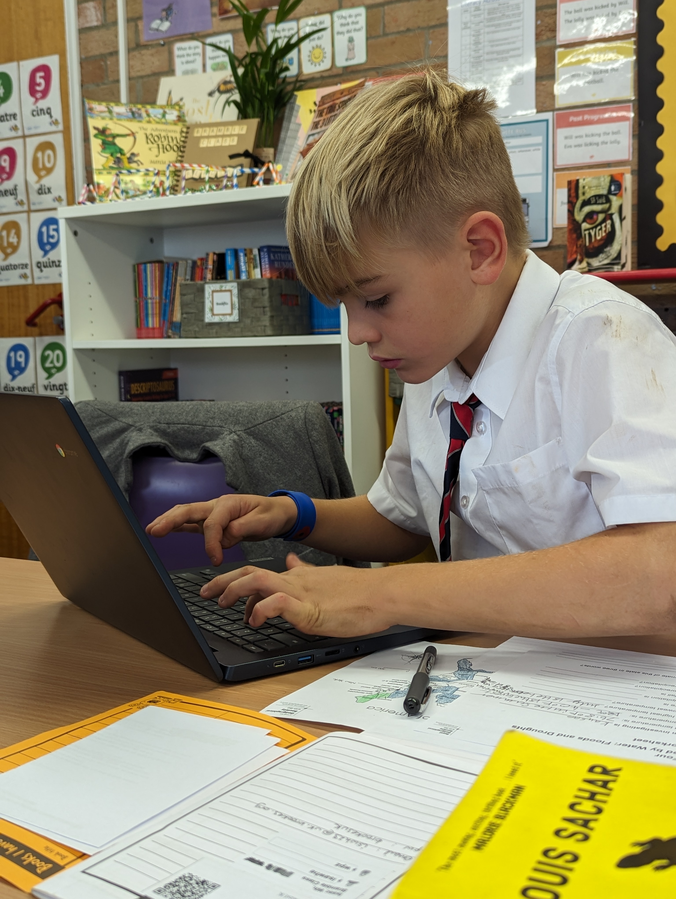
These are Year 5 & 6 using ICT for research during a Geography lesson. Each pupil chose a different US state to research the different climatic conditions including average annual temperatures across the year, levels of precipitation and snowfall. In class we discussed reasons for the North/South temperature differentials and the East/West precipitation levels.
Bramble class news

Slide 14
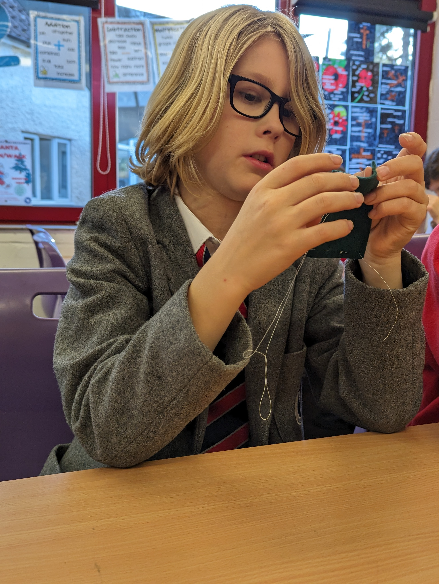
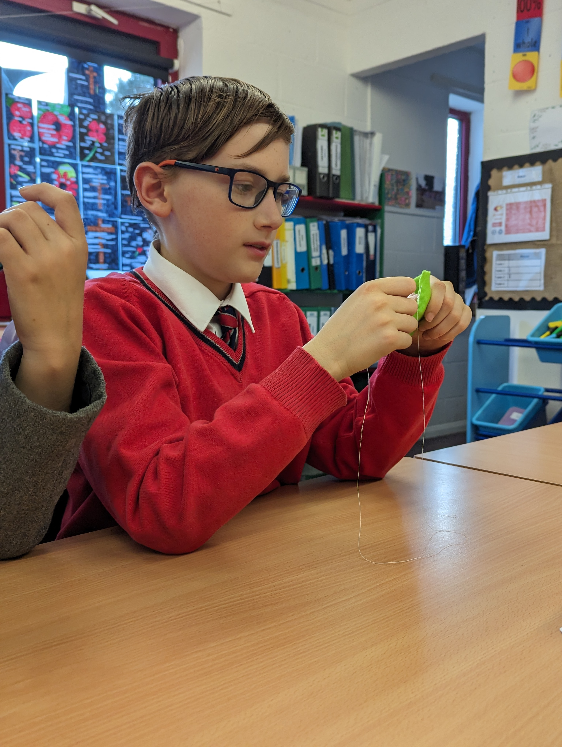
DT lesson learning sewing skills for creating a lizard-shaped felt pencil holder
Bramble class news

Slide 15
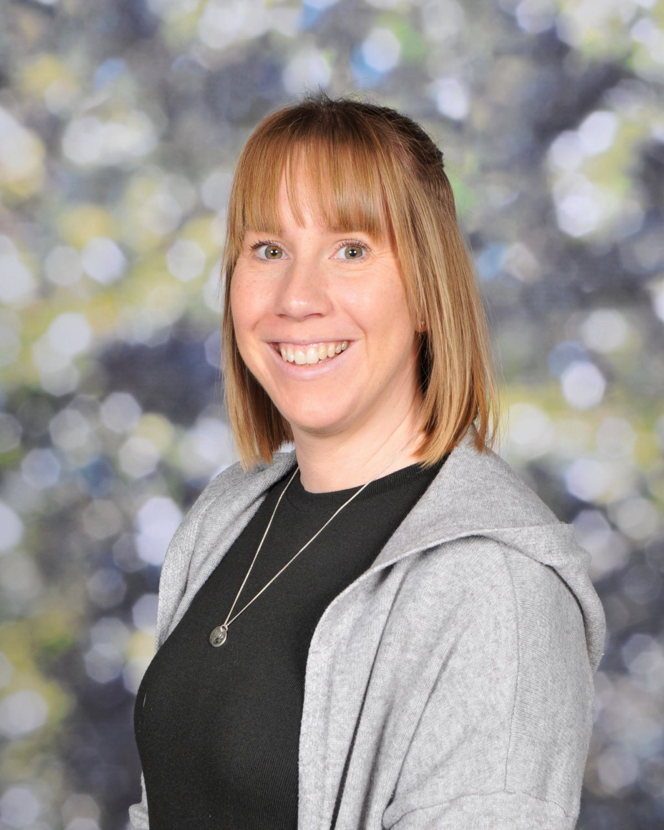
Student Well Being
Pastoral care provides an extra layer of provision to the children at Brookes, ensuring their emotional wellbeing is supported and cared for. Miss Peri formally took on the Pastoral role during the summer term. She has enjoyed getting to know the students and their personalities. Miss Peri’s wellbeing room offers a safe environment where she can listen to each child to better understand any areas of concern a child may have. Miss Peri firmly believes a child should never just survive school, all students should be content and thrive within a safe environment.
Miss Peri says
“ my role is so rewarding and important, I look forward each day to spending time with our lovely students and to supporting them in all areas of school life”

Slide 16
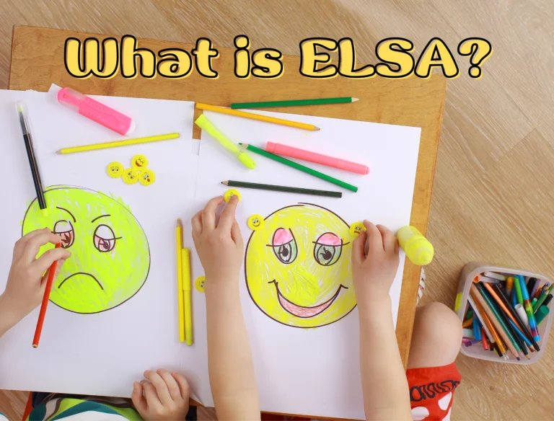
Student Well Being
Emotional Literacy Support Assistant
What is ELSA and who can benefit from this service?
ELSA offers individual sessions as well as group sessions, it is a time where feelings can be shared in a safe and non judgmental environment. The trained Elsa practitioner works with the child, carefully planning activities that encompass a learning objective.
ELSA group sessions have emotional welfare at the heart of each session. Children are encouraged to work together in sharing feelings and experiences which help with social skills, friendships, and all work to achieve a sense of belonging.
Our Elsa staff work with children to help them become more secure and confident in school assisting them to reach their educational potential. Miss Heidi and Miss Nicole are both ELSA trained and highly experienced in delivering ELSA.
They are totally committed to delivering an emotional wellbeing service that enriches the lives of all students who require additional support.

Slide 17
House News
Every student at Brookes is placed in one of our three pastoral Houses. Throughout the year they compete in challenges and competitions to gain valuable points towards the overall House competition.
We began the year with a whole school competition to design new House logos, to go with our new House names - which are Falcons, Hawks and Eagles. Henry Barron was our elected winner with a fantastic design. With our new house names, new house logos and new house captains, we were ready to reinvigorate our House programme.

Slide 18
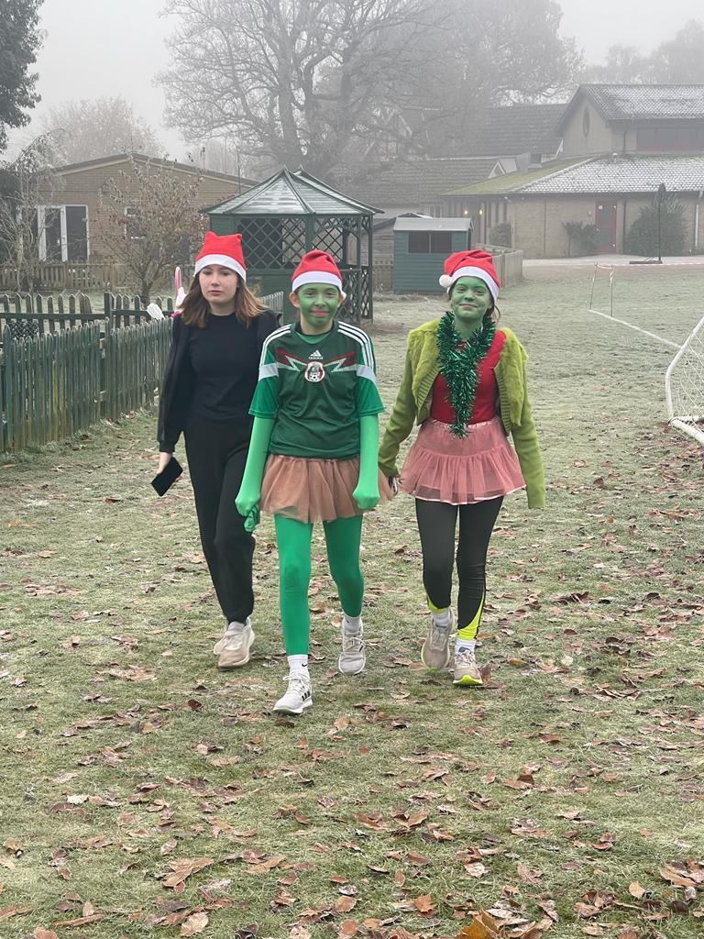
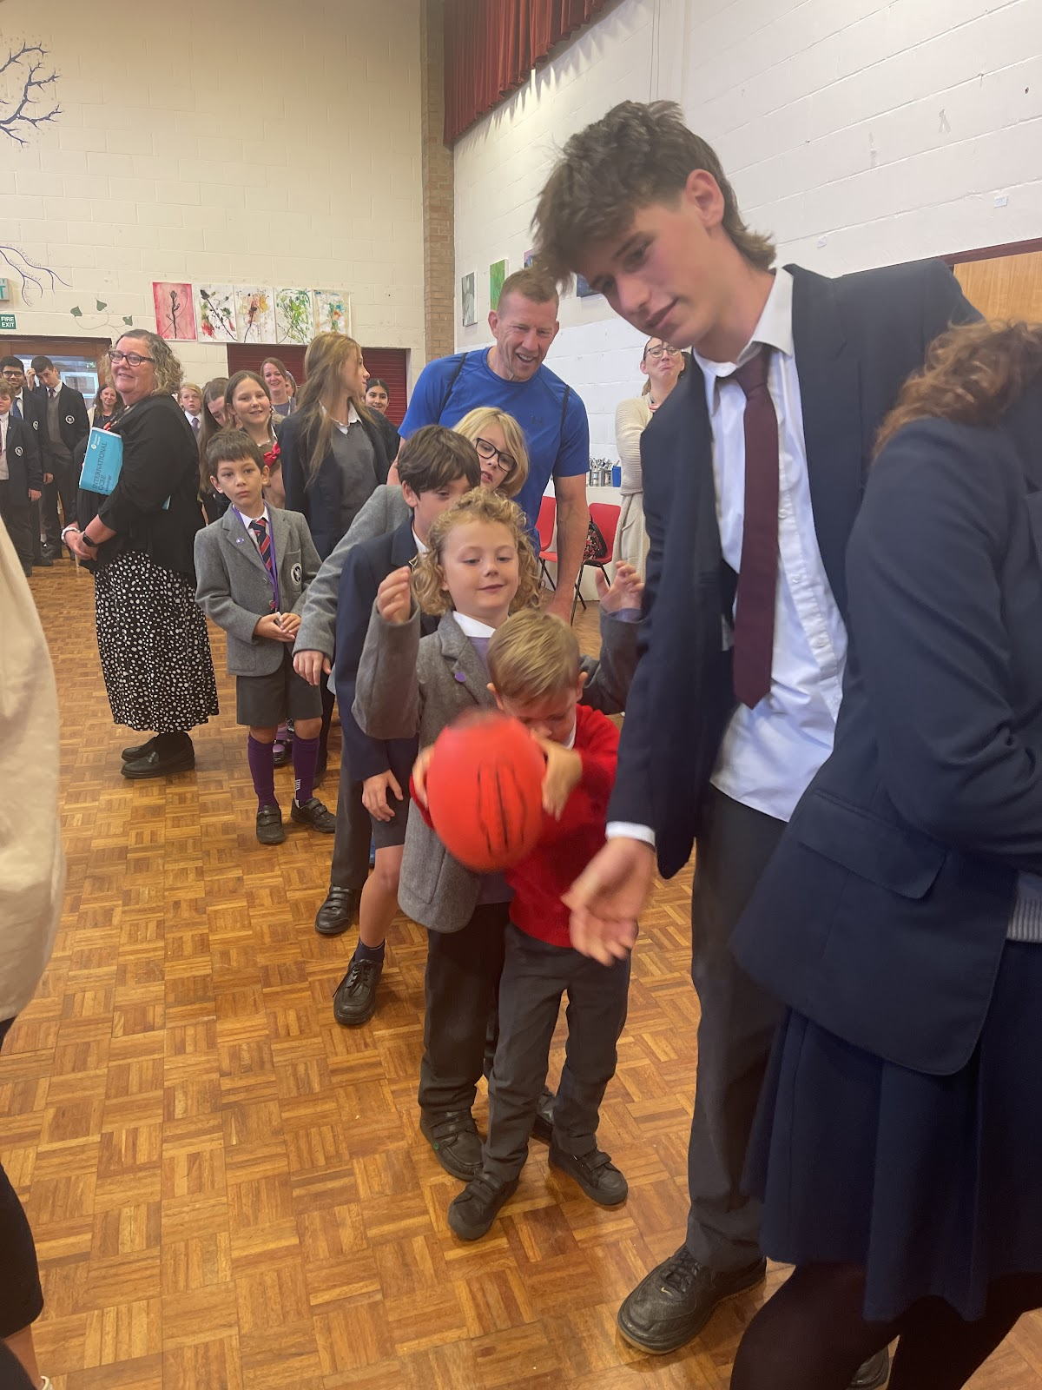
House News
Since the beginning of the year students have competed in various year group, individual and whole school competitions. We have seen an increase in individual House points being awarded, which all add up to the overall total. Students receive certificates and badges according to the number of points received. At the end of this term we will have a total of 65 students receive various awards. House Competitions include our monthly fitness challenge, Colour Day, Penny Wars, Christmas Assembly, Saturday Cross Country Series, Photography and many more.
The students have been amazing in bringing such positivity and energy to the House programme and we are only just getting started.

Slide 19
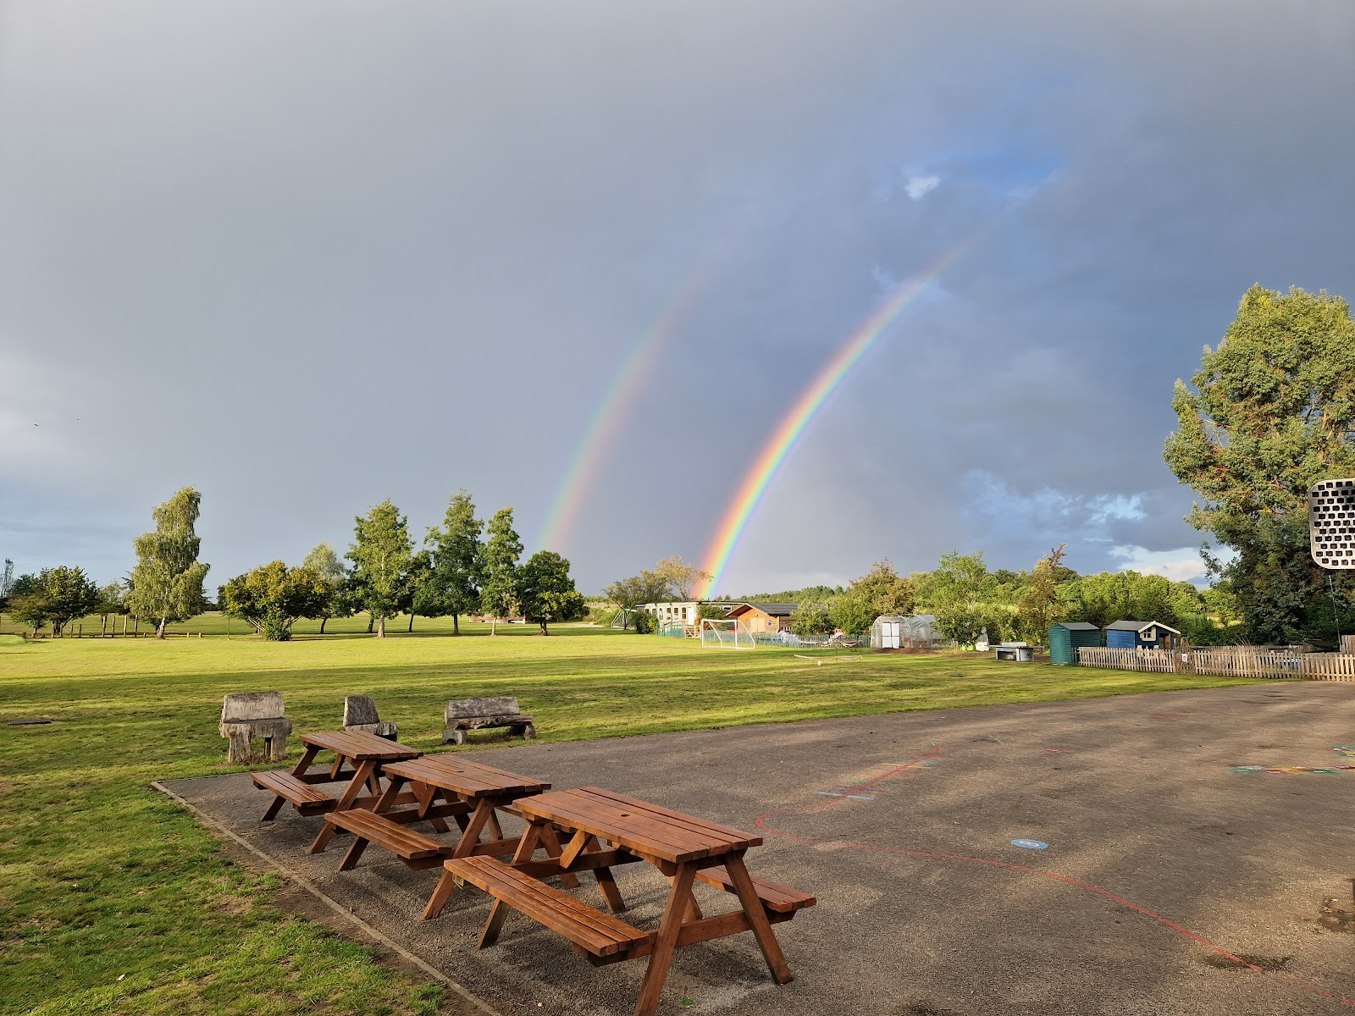
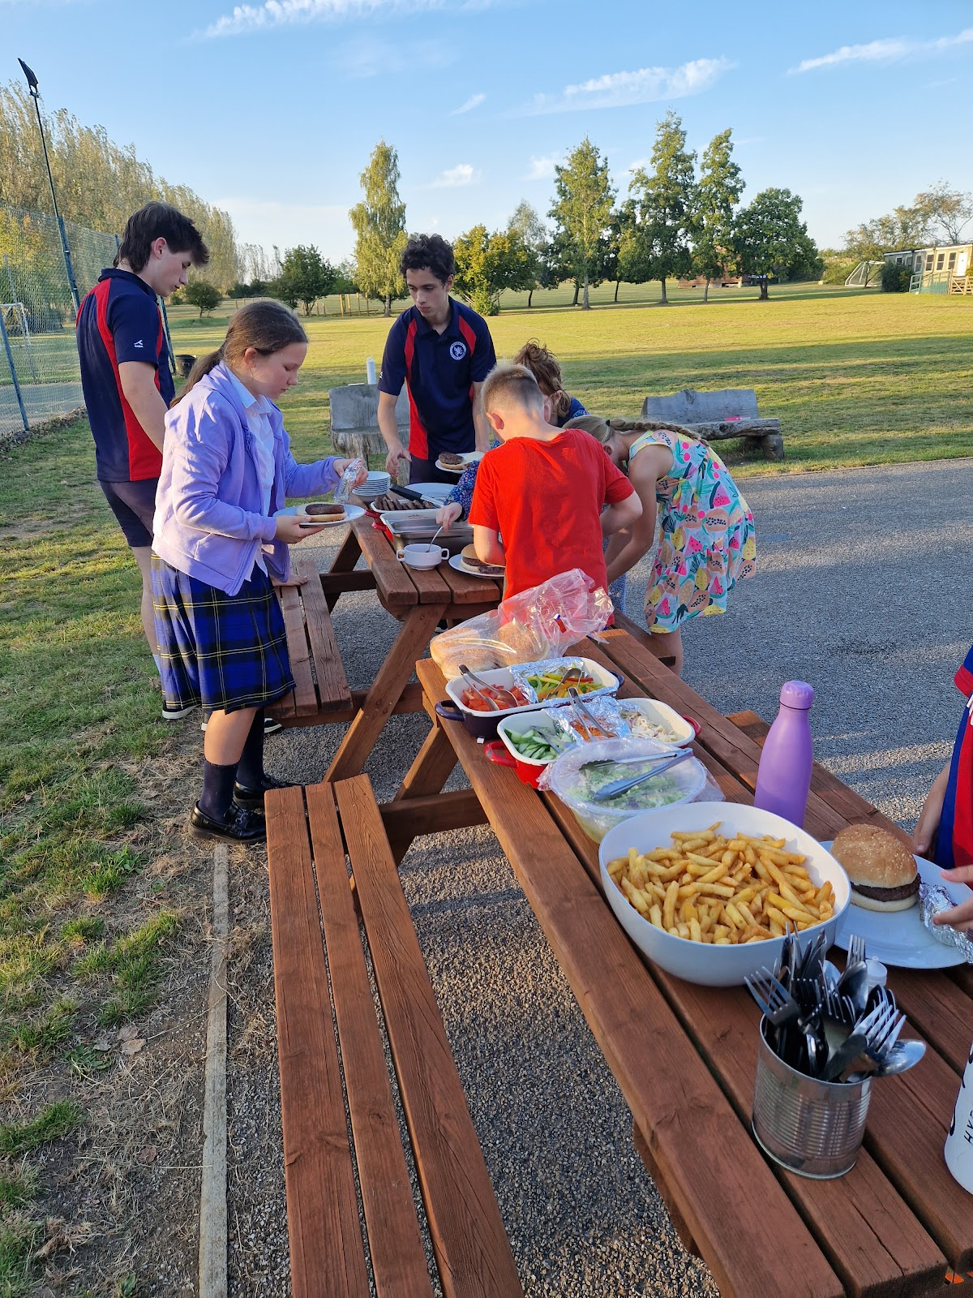
Boarding House News
As we close the Boarding House doors for the Christmas Holidays, we take time to reflect on the busy, vibrant and festive term. The Boarding house really does feel like a home away from home. The Boarders are coming together as one big family, they look out for each other and really enjoy each other's company in and out of school hours. This year we welcomed two new Boarders, one from Mexico and one from England. We have so many highlights it would be impossible to list them all. We started the year with a wonderful welcome back BBQ, enjoyed in our fabulous setting.

Slide 20
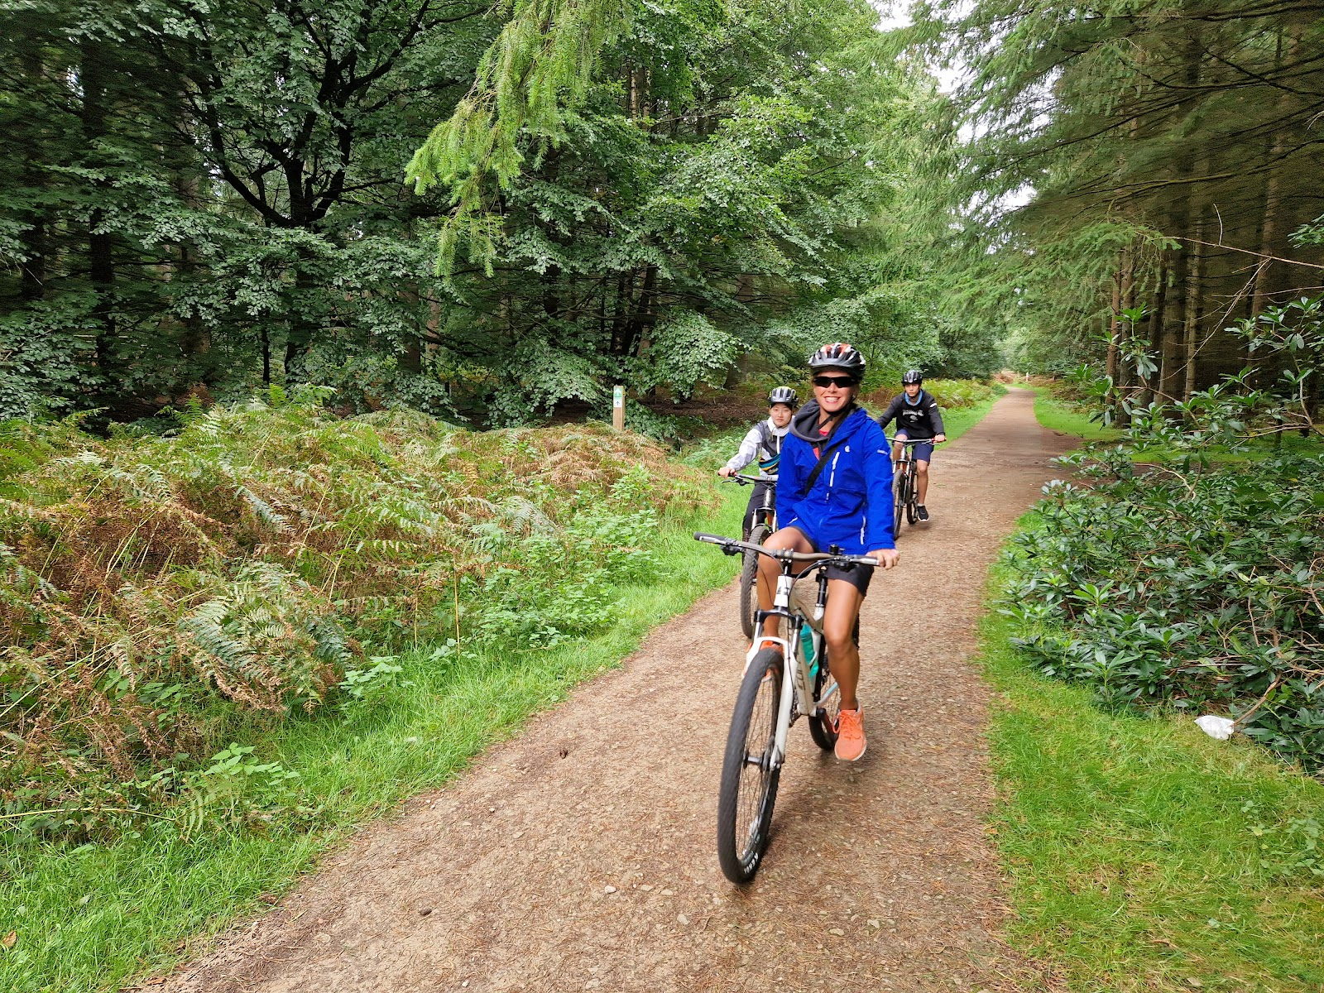
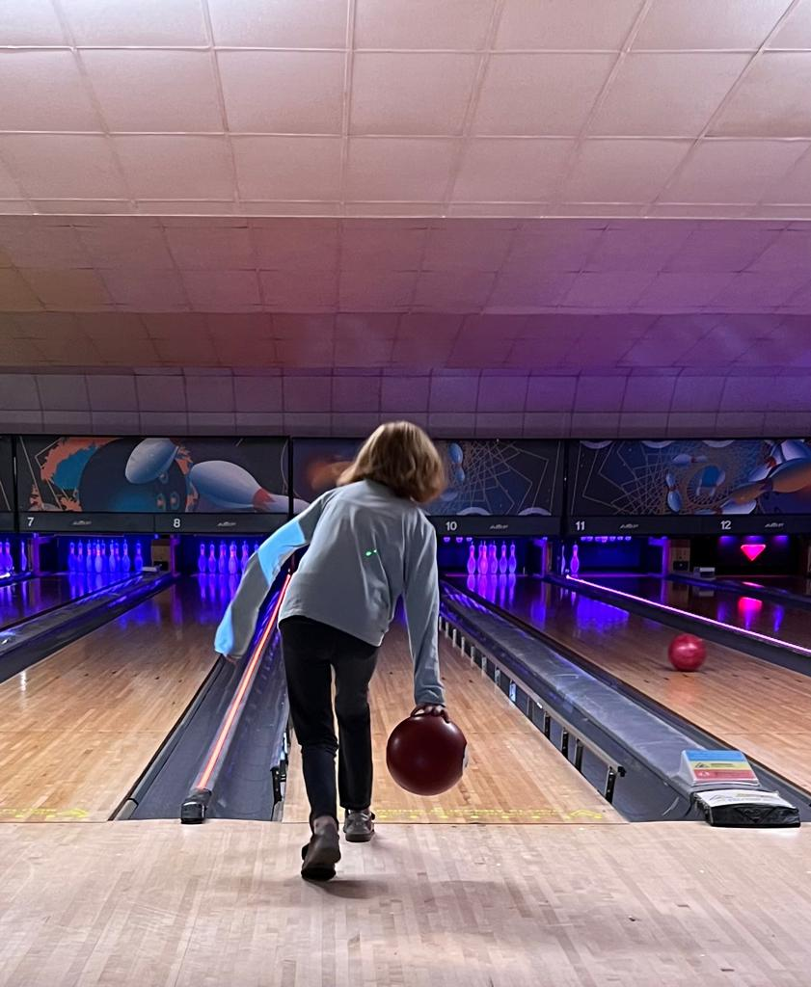
Boarding House News
Every weekend the Boarders participate in a variety of activities. This term they have been to the beach, enjoyed a bike ride at High Lodge, Bowling at Bury Bowl, enjoyed walks in the park and were entertained by the travelling circus. As the weather changed and being outdoors began a little more challenging, the Boarders enjoyed the challenge of trying to escape from the many different Escape Rooms, finally they managed to escape this year. More recently we have enjoyed the festive season by decorating the Boarding House, watching ‘Snow White’ at the local theatre, gingerbread house building and seeing the phenomenal illumination display at Sandringham Estate.
‘
“We are looking forward to hearing about everyone’s Christmas holidays when we welcome everyone back in the new year”

Slide 21
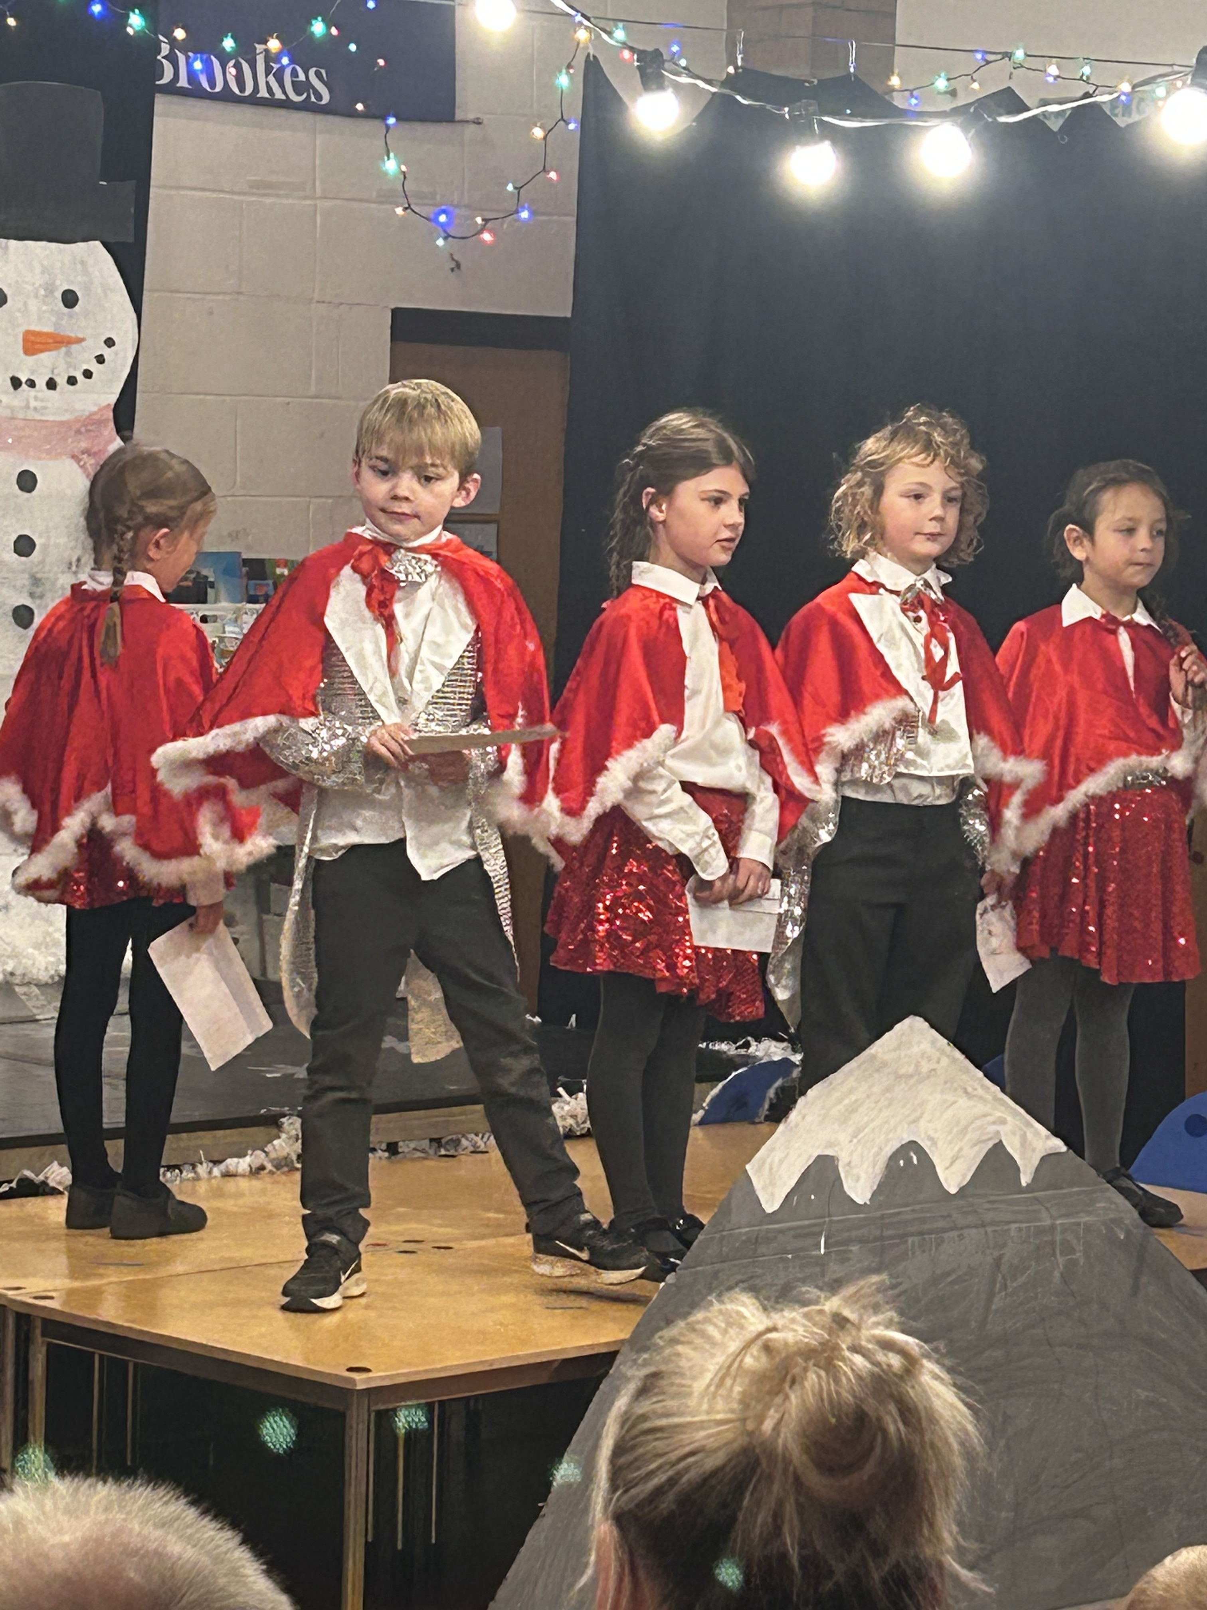
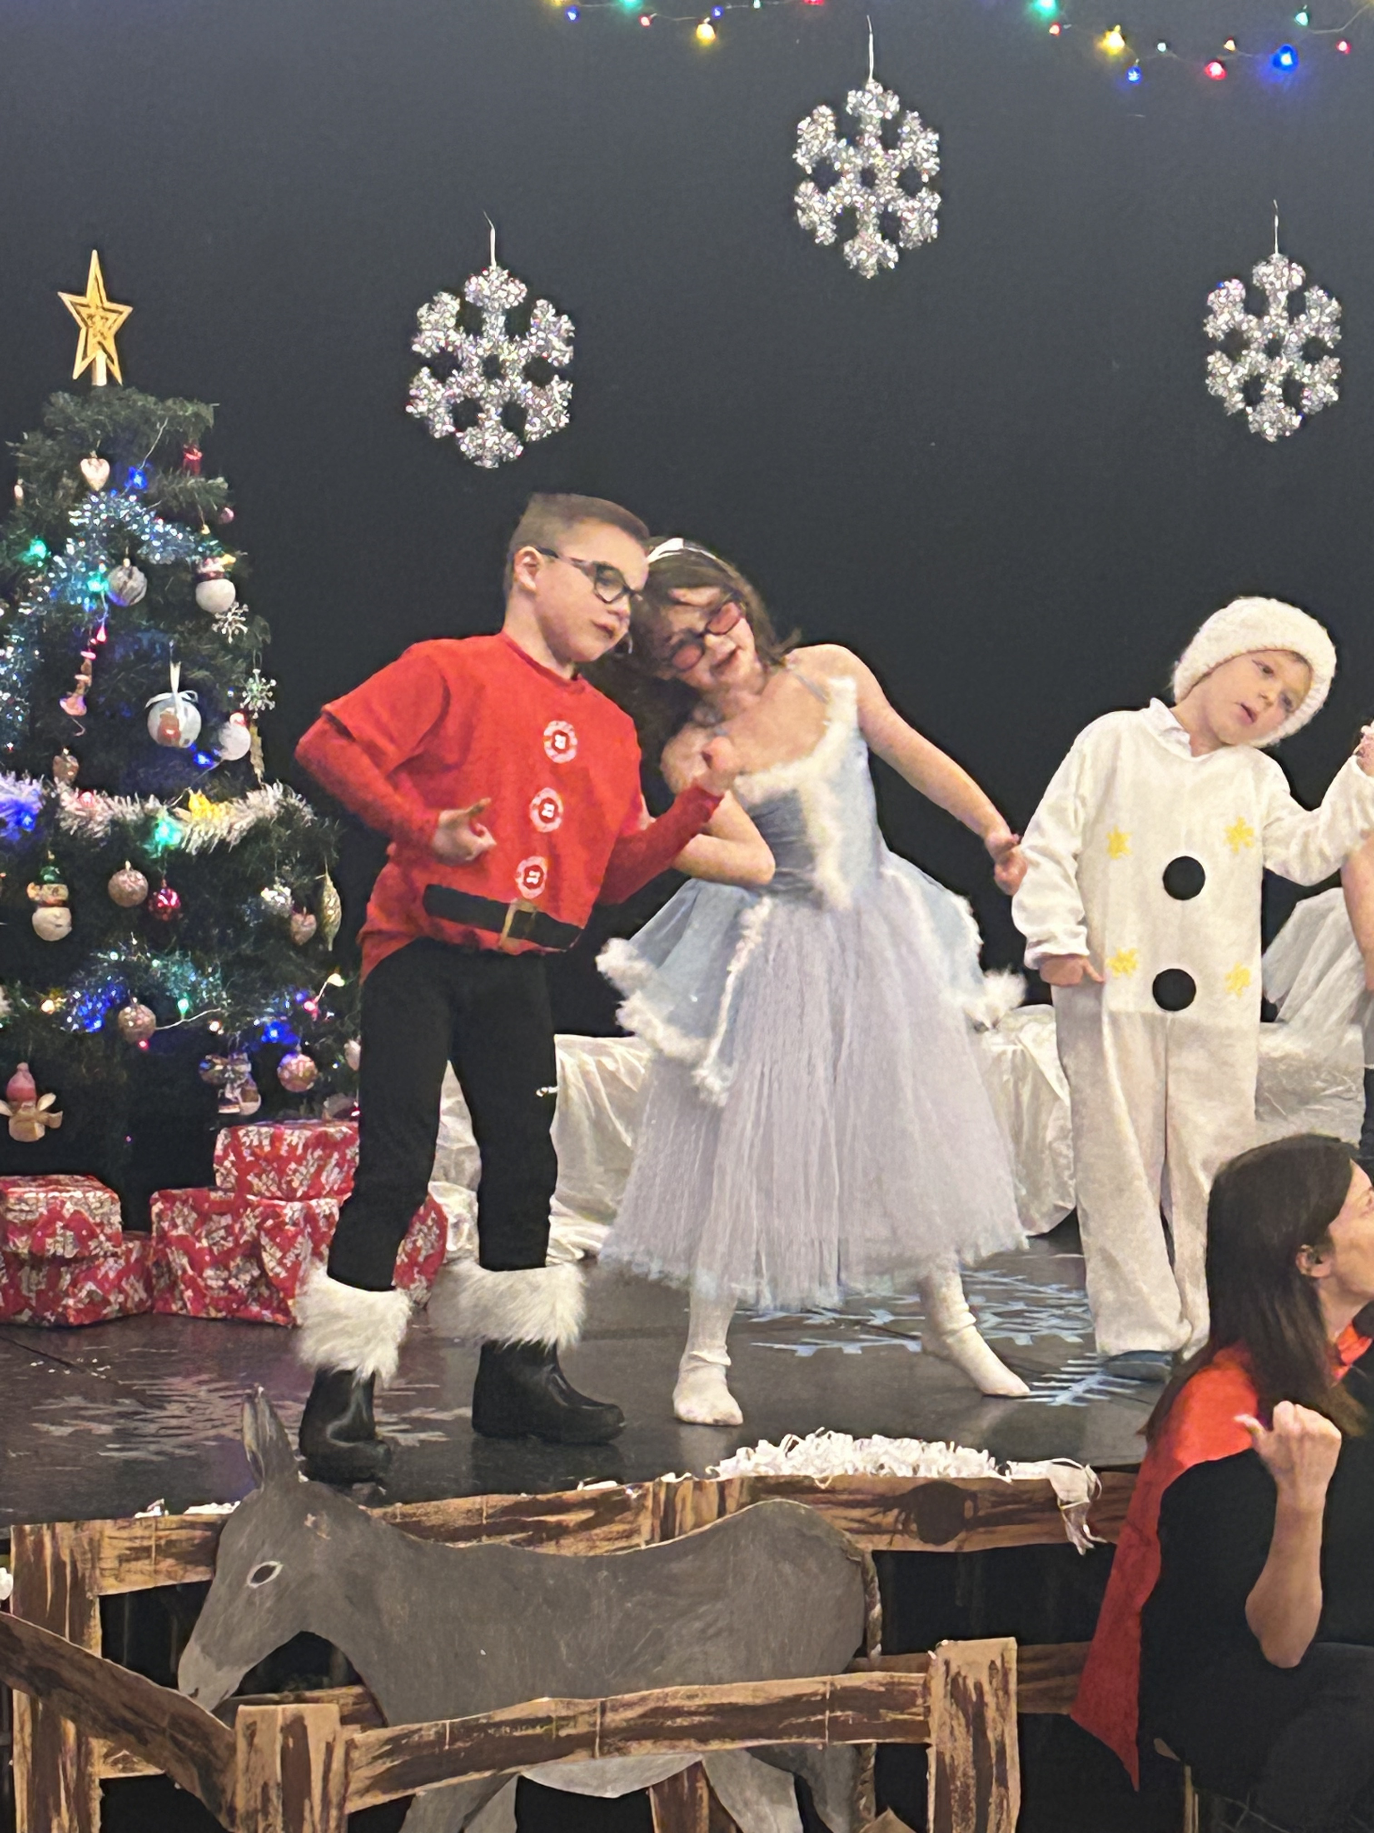
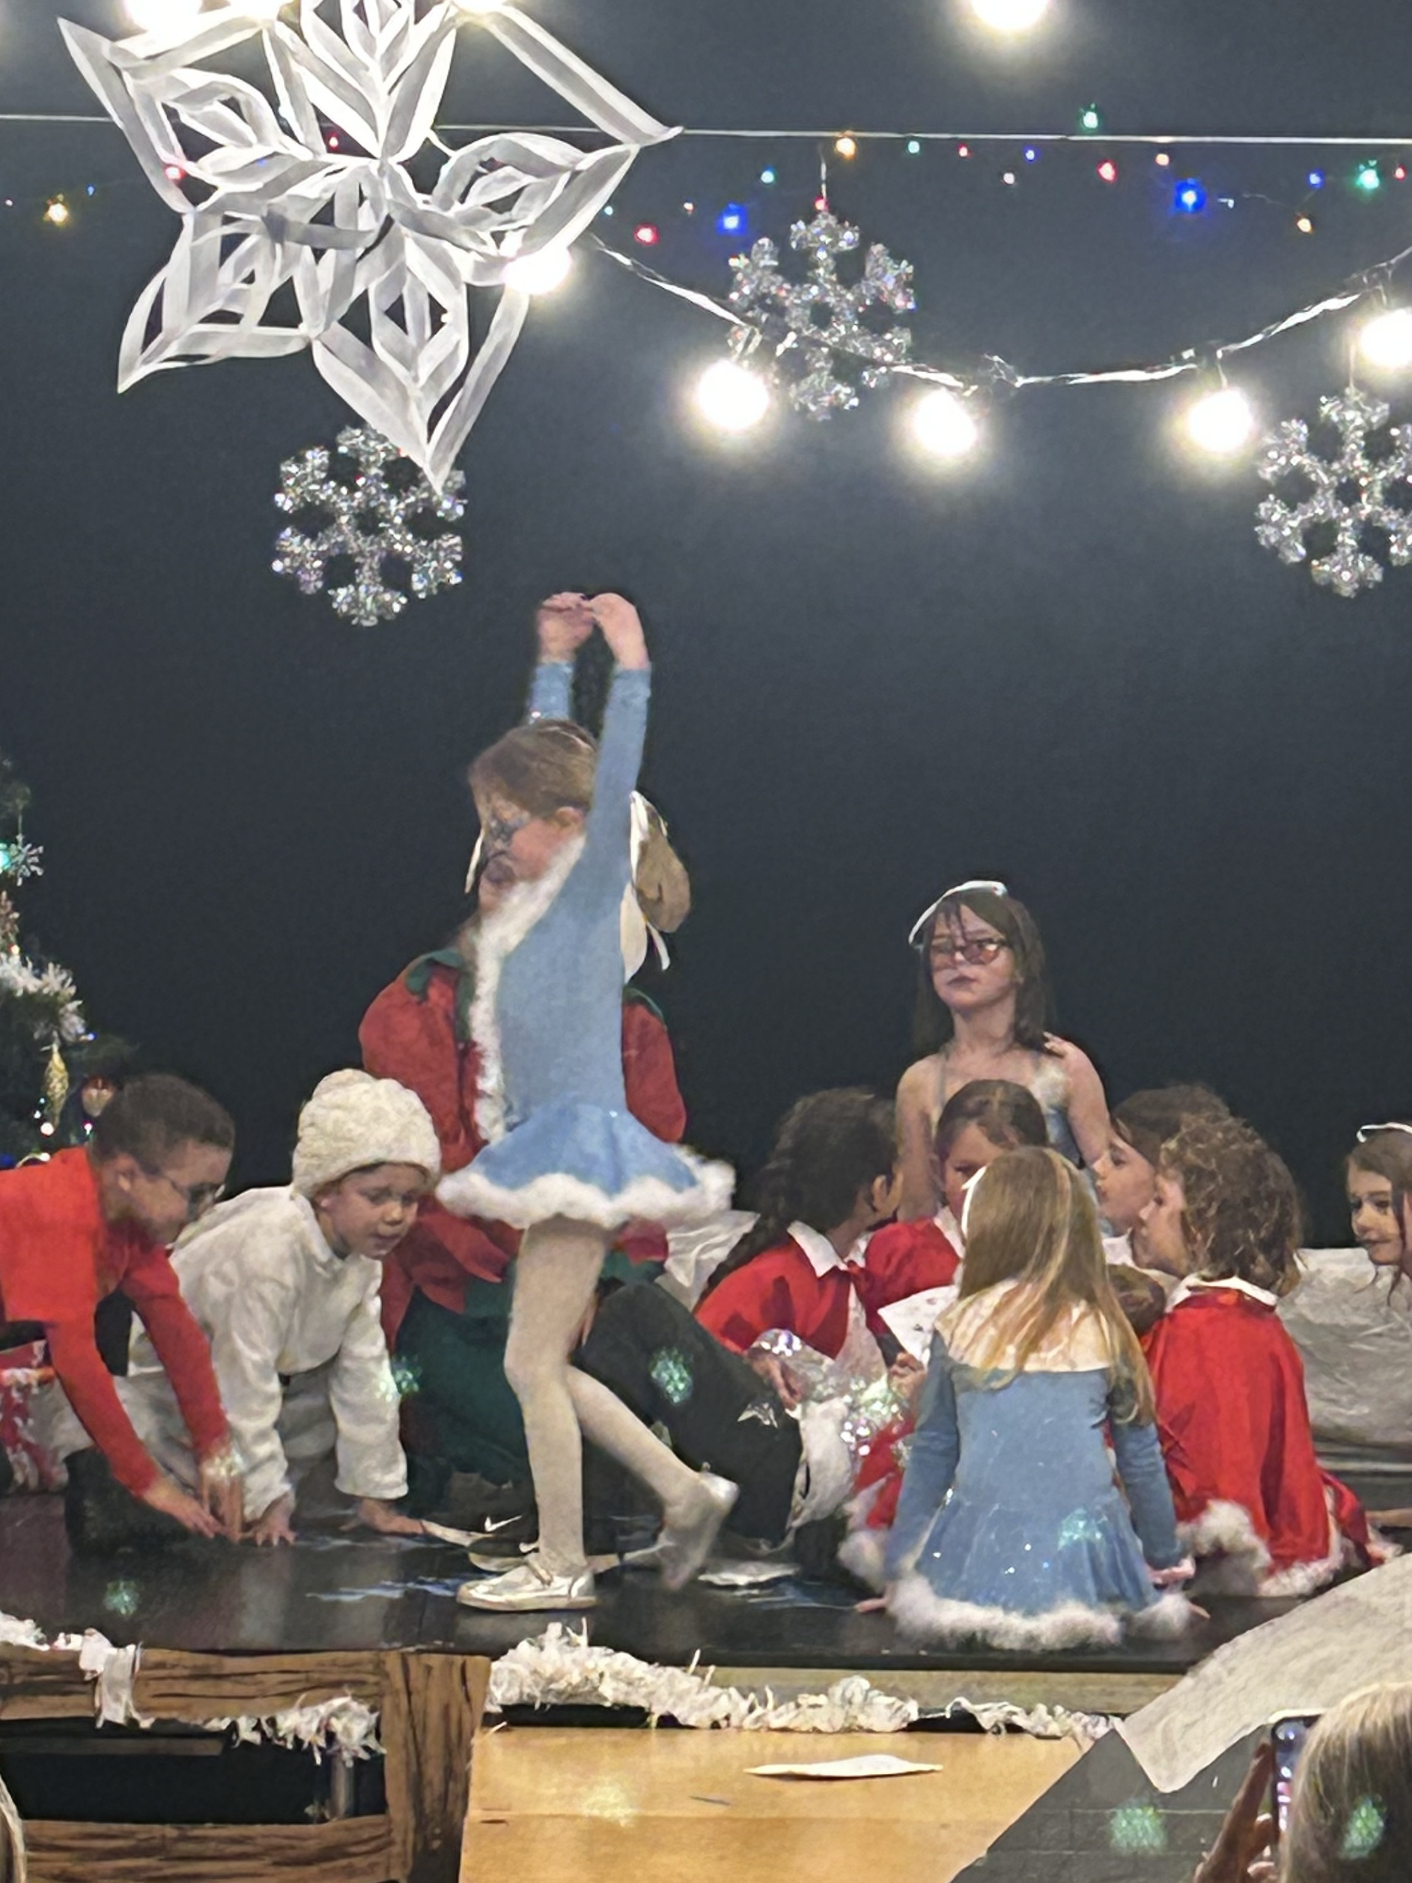
Christmas in Pictures

Slide 22
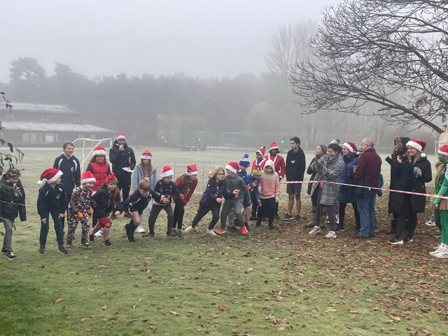
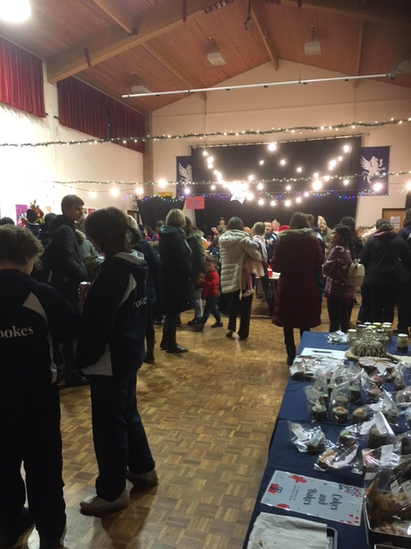
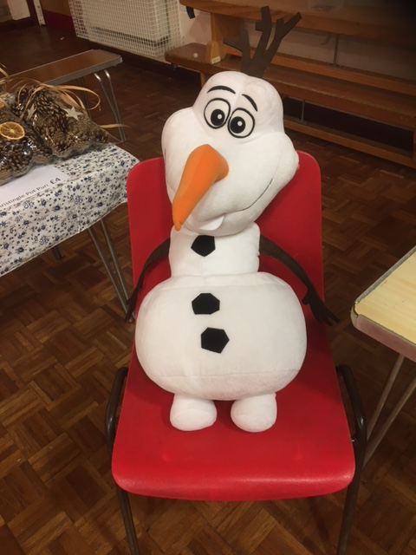
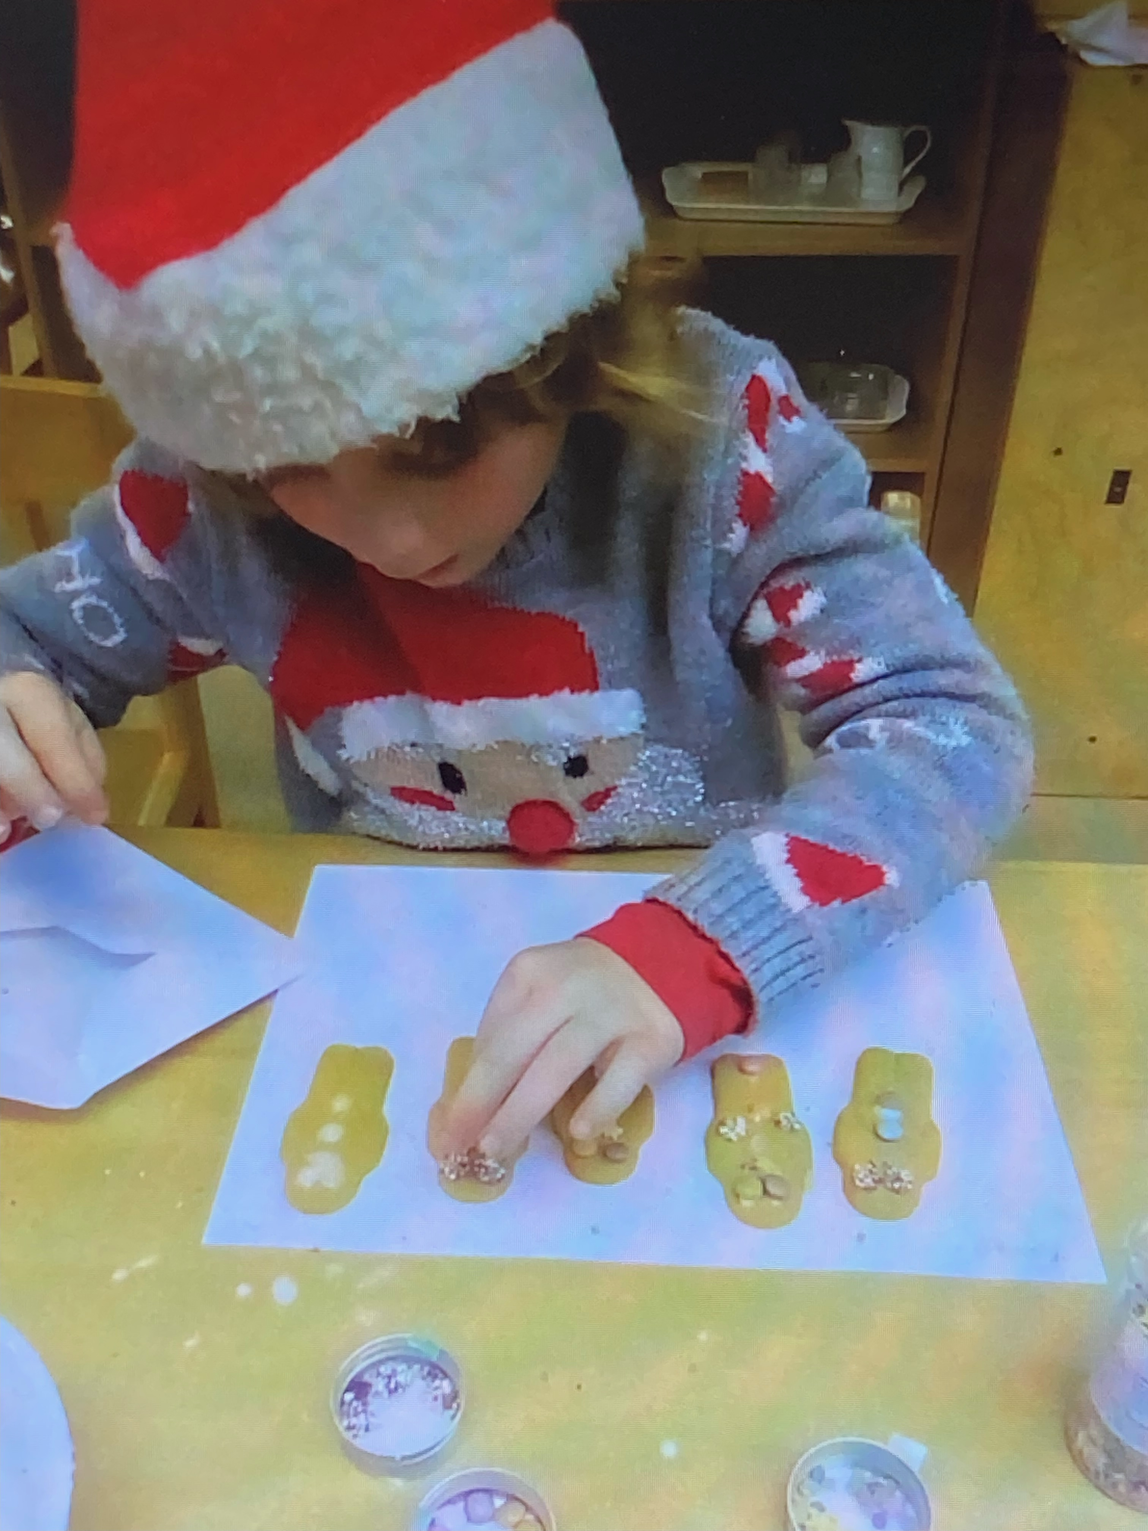
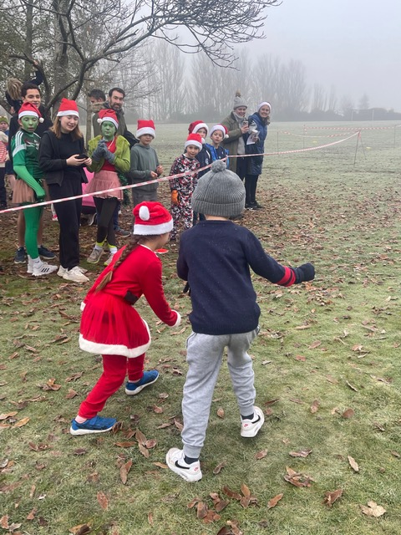
Christmas in Pictures

Slide 23
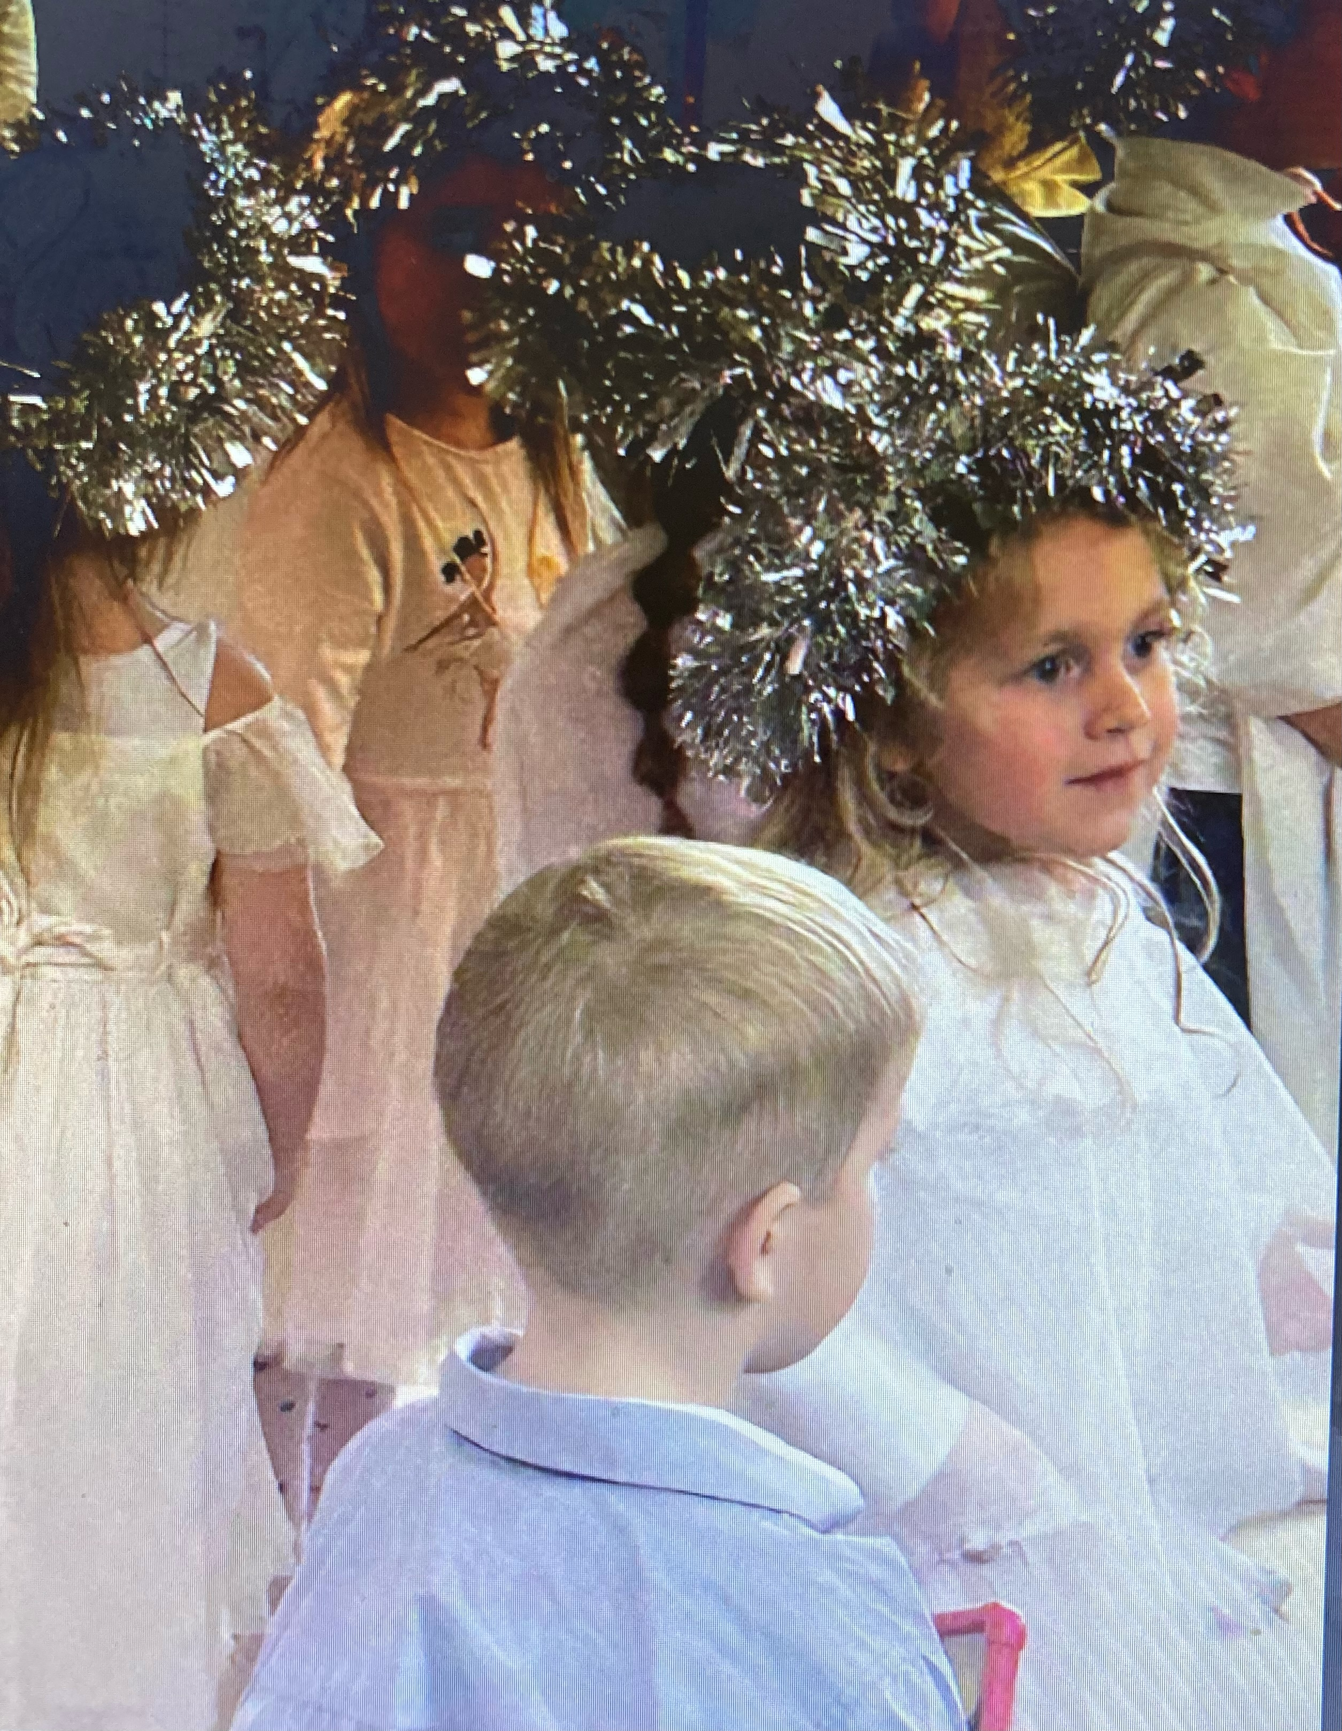
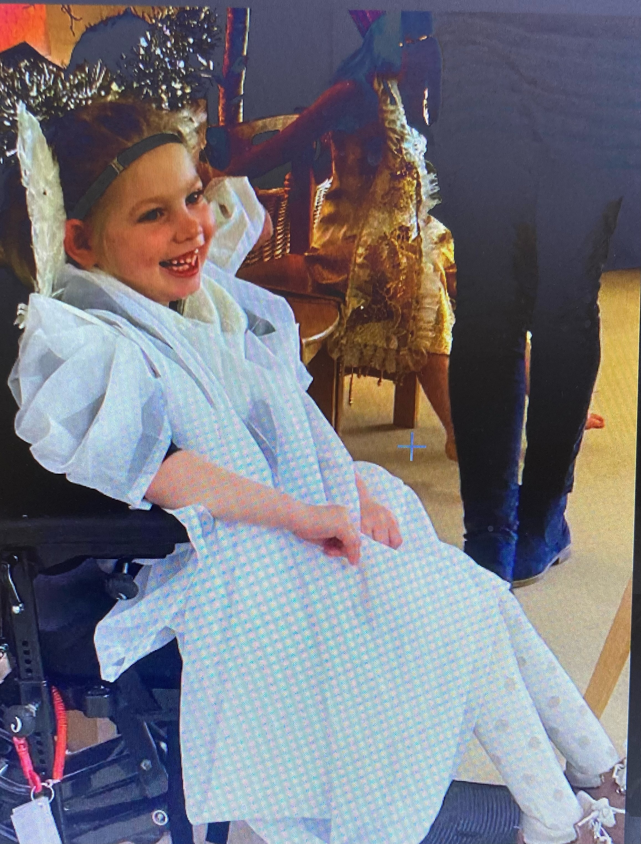
Christmas in Pictures

Slide 24
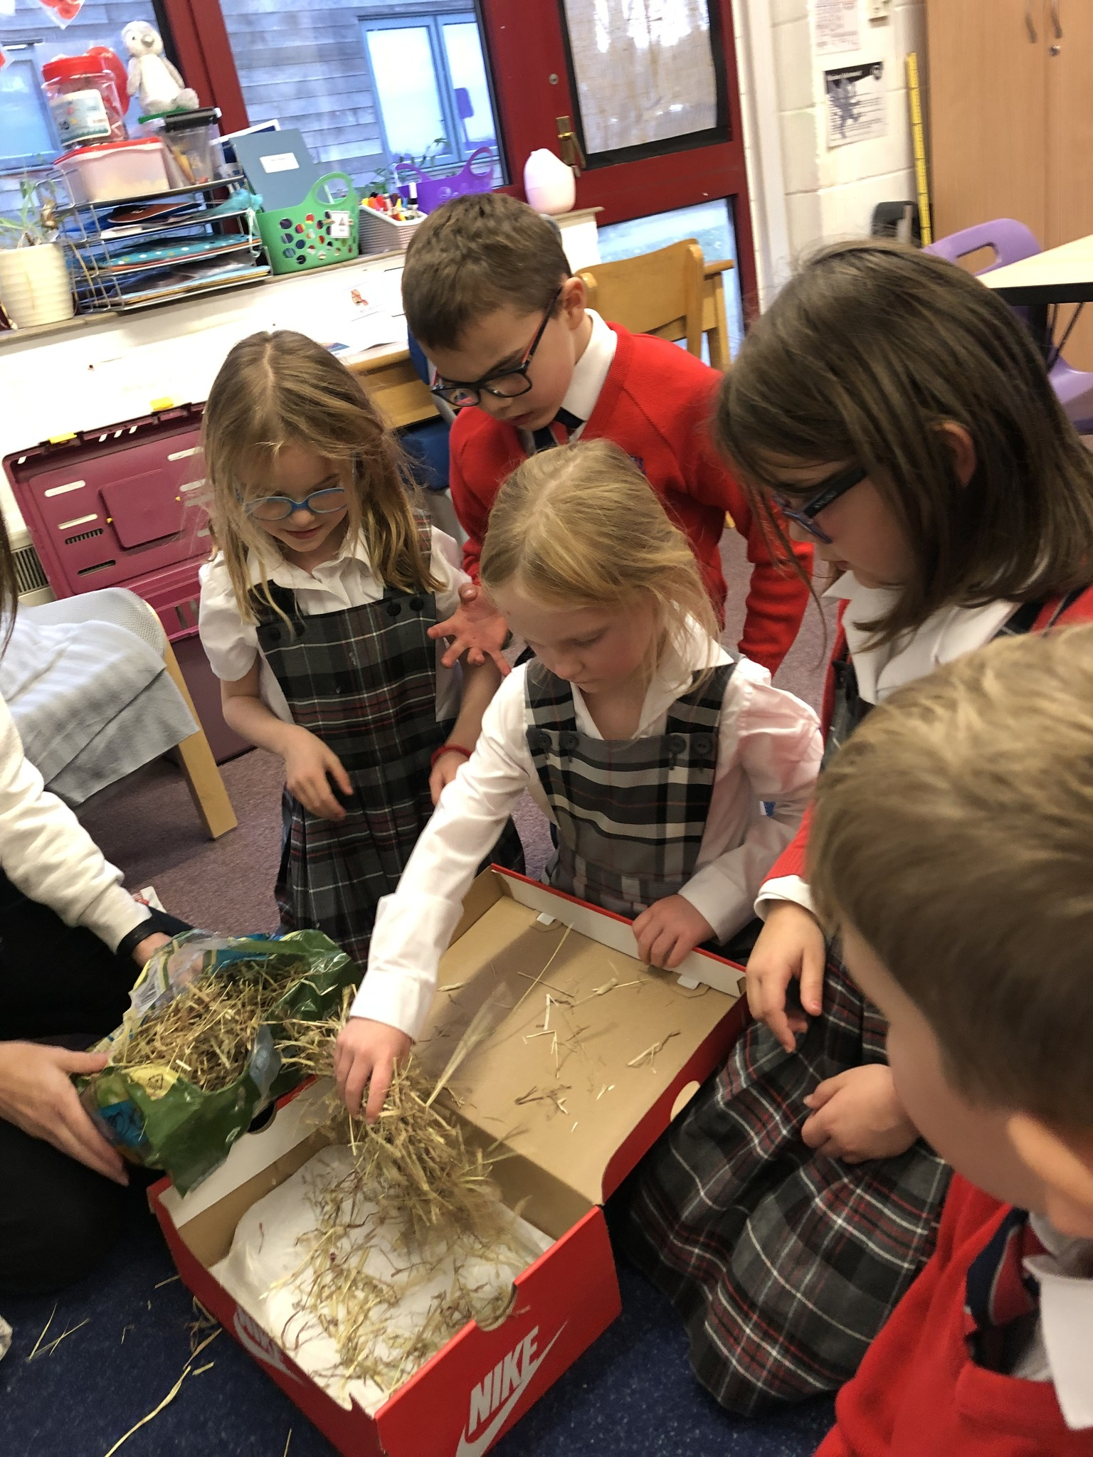
And finally…………
the children from Dandelion class had a special visitor to their science lesson, Steven the pet tortoise. The class has been exploring wild and wonderful animals by categorizing them and have started to look at pets. Steven brought great joy to the lesson, allowing them an insight into the world of reptiles. The class assisted with getting him hibernation ready, by washing him and preparing his bed.
Good night Steven!
Published by Melanie Nichols
Contributions from; Helena & Paul Jackson, Helen Childerhouse,
Natalie Taylor, Sarah Elford and Emma Herd, Bill Pipe, Vanessa McAndrew, Claire Gale, Jennie Donlan, Perri Carter, Heidi Nunn and Leanne Livall.

